Slide 1
CEG4131 – Fall 2017
GPGPU
CEG4131 – Fall 2017
University of Ottawa
Notes:
Introduction
GPU
Programming

Slide 2
Introduction
History
OpenCL Board
OpenCL Overview
OpenCL Examples
History
OpenCL Board
OpenCL Overview
OpenCL Examples
AMD OpenCL Tools

Slide 3
Introduction
History
OpenCL Board
OpenCL Overview
OpenCL Examples
The rise of the GPU 1990s
Source: Wikipedia; Kaufman et al. (2009)
Notes:
DP 10X
SP 7X

Slide 4
Introduction
History
OpenCL Board
OpenCL Overview
OpenCL Examples
GPUs – a decade ago
Source: Wikipedia
Notes:
DP 10X
SP 7X

Slide 5
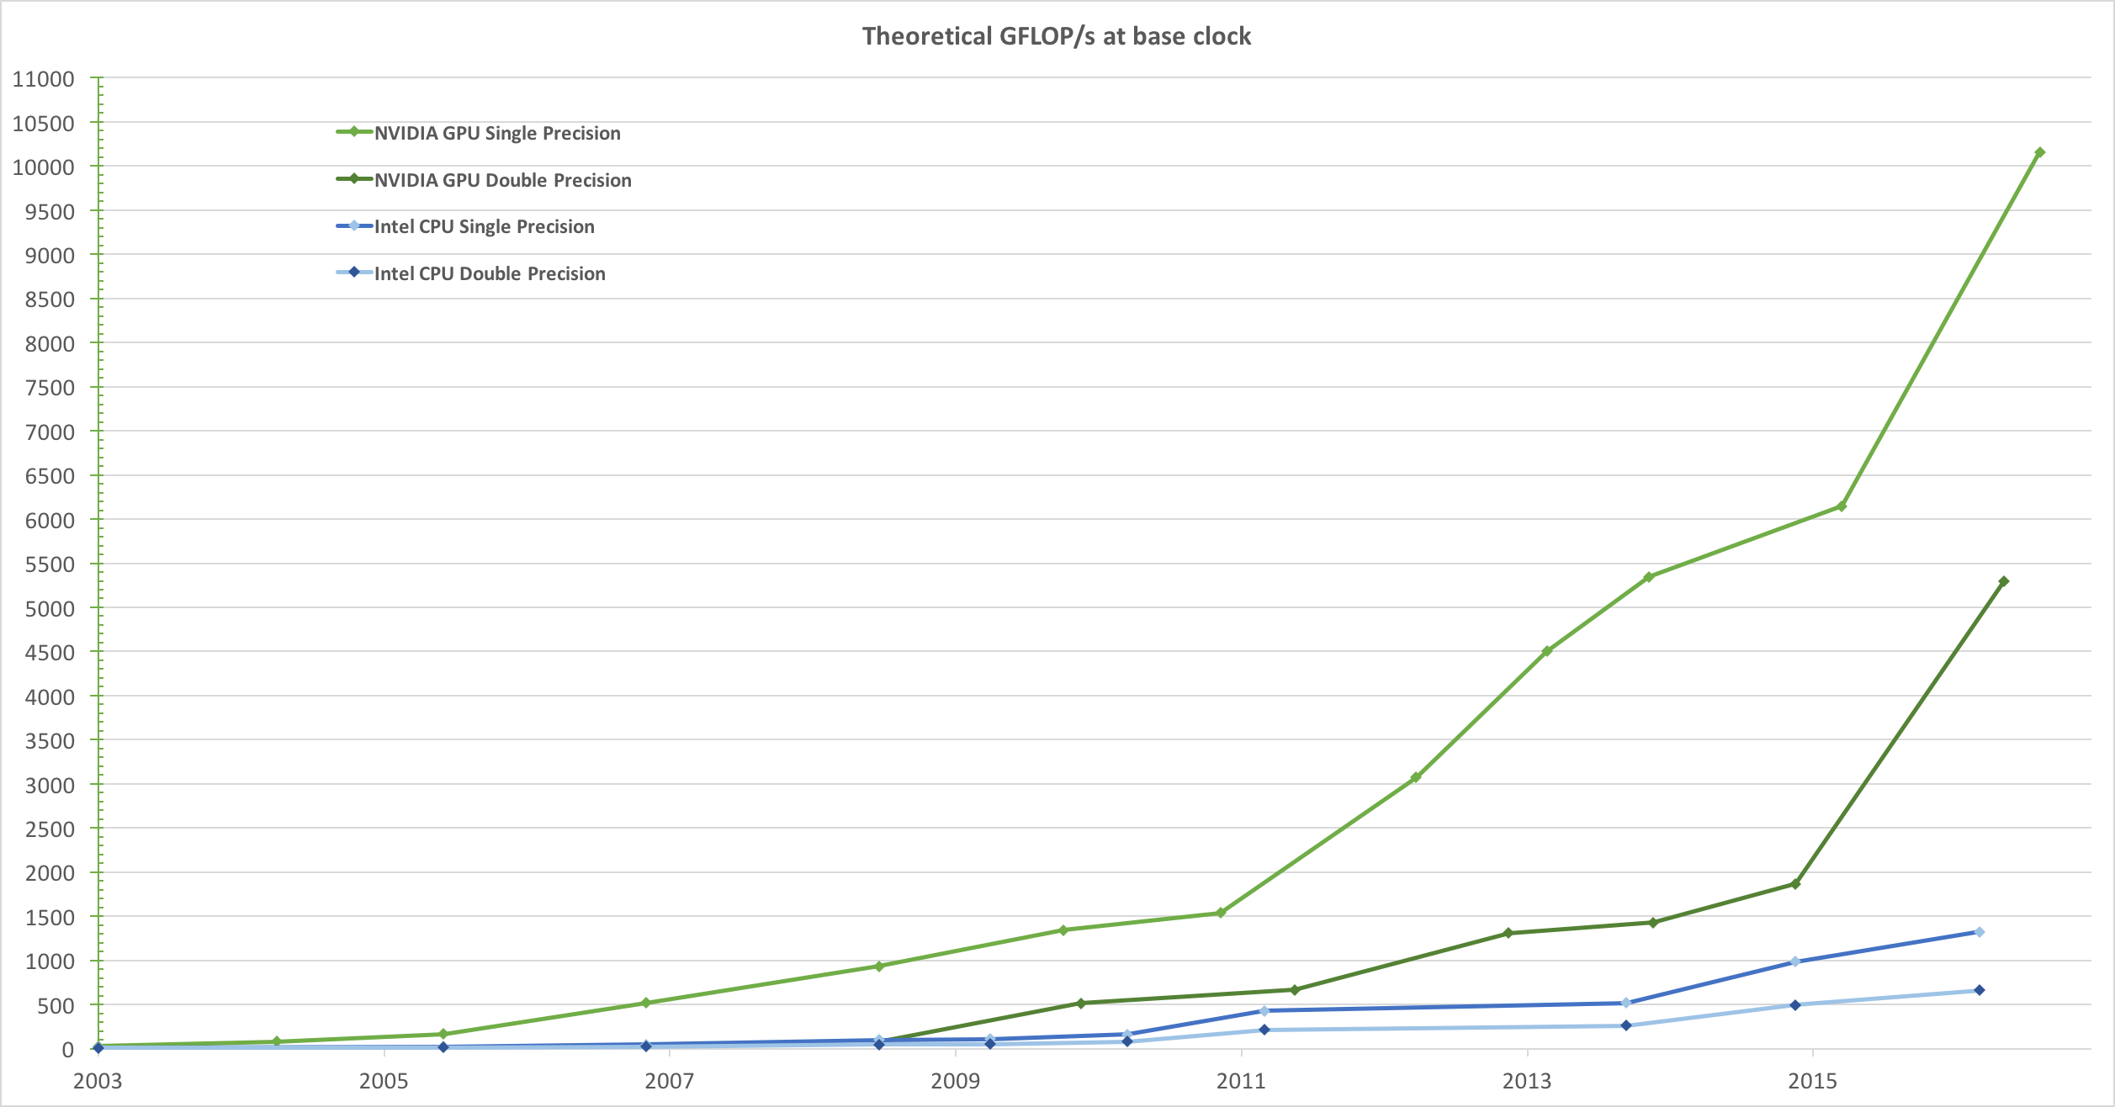
Introduction
History
OpenCL Board
OpenCL Overview
OpenCL Examples
GPU Performance Today
Source: NVIDIA CUDA C Programming Guide
Notes:
DP 10X
SP 7X

Slide 6
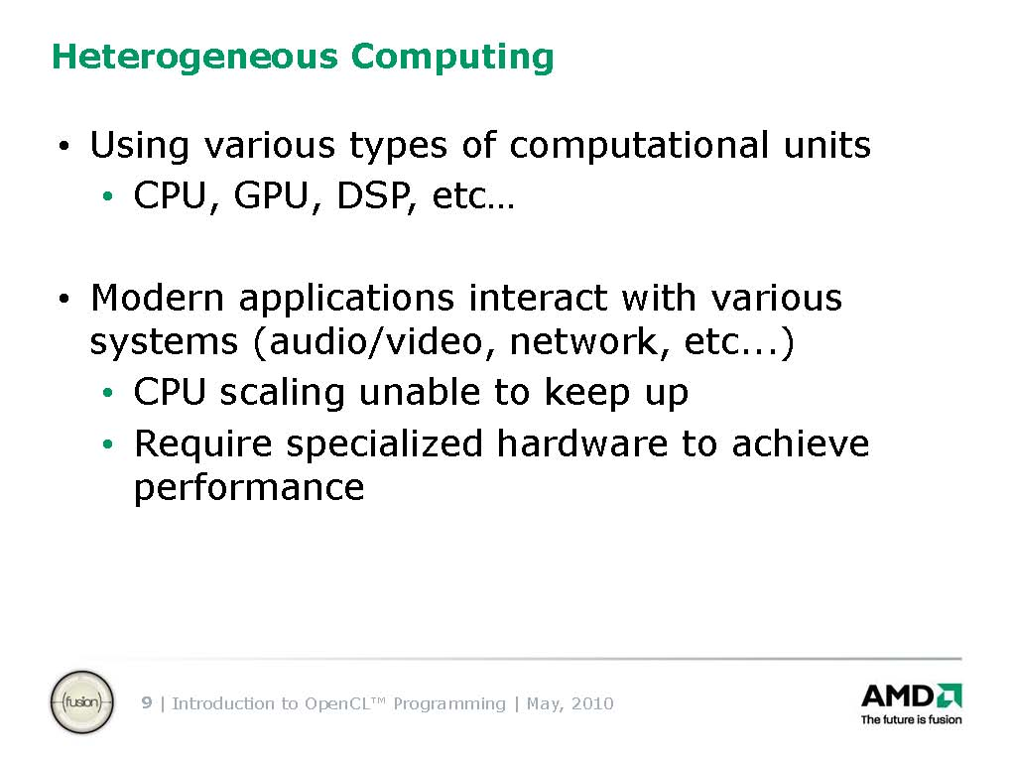
Introduction
History
OpenCL Board
OpenCL Overview
OpenCL Examples

Slide 7
Introduction
History
OpenCL Board
OpenCL Overview
OpenCL Examples
Heterogeneous Computing
GPU
Image Signal Processor
Security Suite
Notes:
Latest from Qualcomm, powers the Samsung Galaxy S8, Nokia 8, etc.

Slide 8
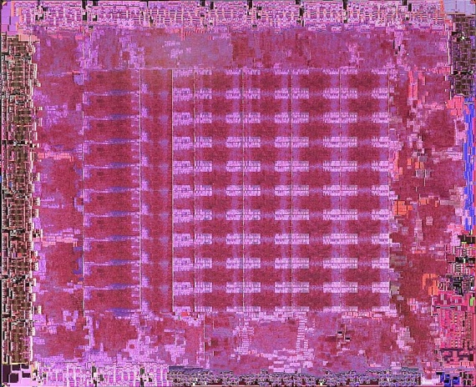
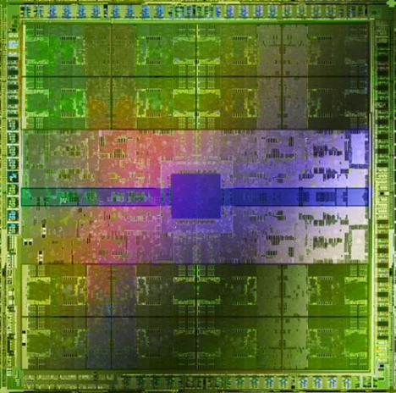
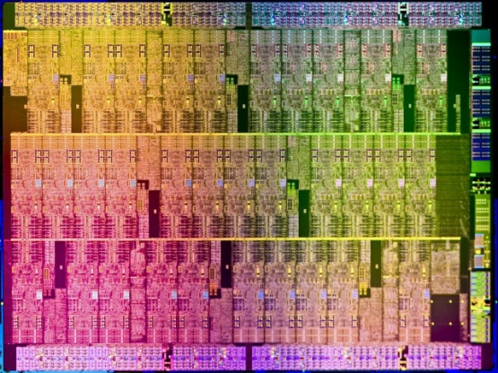
Introduction
History
OpenCL Board
OpenCL Overview
OpenCL Examples
Heterogeneous Computing
10 cores
16 wide SIMD
72 cores
16 wide SIMD
16 cores
32 wide SIMD
ATI™ RV770
Intel® Xeon Phi™
NVIDIA® Tesla® C2090
The Heterogeneous many-core challenge:
How are we to build a software ecosystem for the Heterogeneous many core platform?

Slide 9
Introduction
History
OpenCL Board
OpenCL Overview
OpenCL Examples
Industry Standards for Programming Heterogeneous Platforms
Notes:
Latest from Qualcomm, powers the Samsung Galaxy S8, Nokia 8, etc.

Slide 10

Introduction
History
OpenCL Board
OpenCL Overview
OpenCL Examples
The origins of OpenCL
ARM
AMD
Nokia
Merged, needed commonality across products
IBM
ATI
Sony
GPU vendor – wants to steal market share from CPU
Qualcomm
Wrote a rough draft straw man API
NVIDIA
Imagination
TI
+ many more
CPU vendor – wants to steal market share from GPU
Intel
Khronos Compute group formed
Was tired of recoding for many core, GPUs.
Pushed vendors to standardize.
Apple

Slide 11
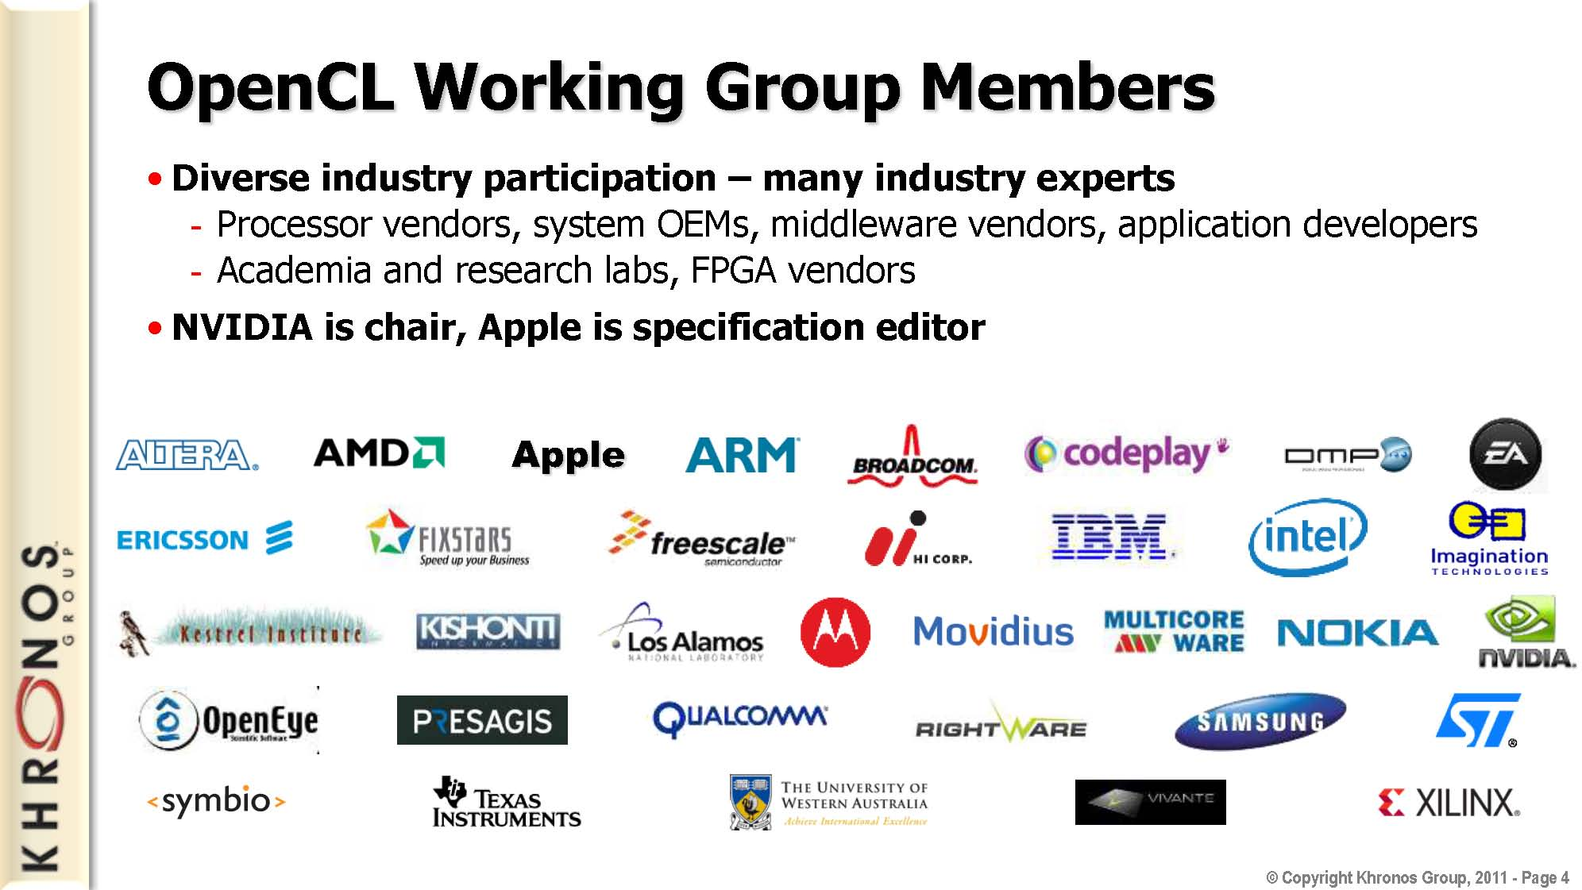
Introduction
History
OpenCL Board
OpenCL Overview
OpenCL Examples

Slide 12
Introduction
History
OpenCL Board
OpenCL Overview
OpenCL Examples

Slide 13
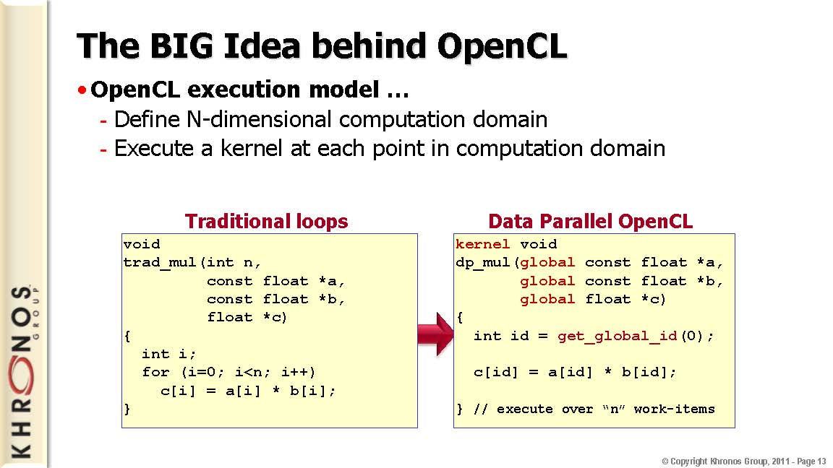
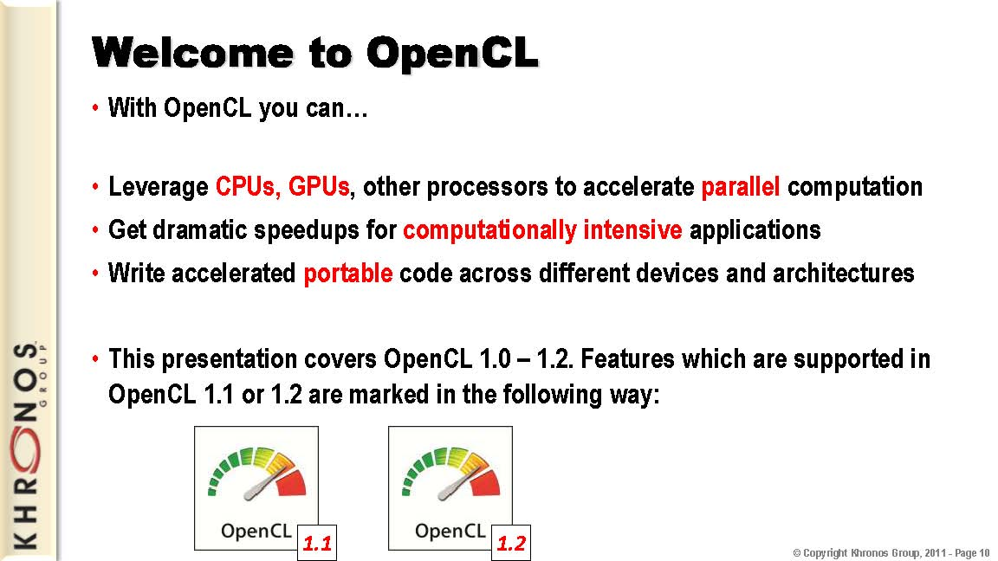
Introduction
History
OpenCL Board
OpenCL Overview
OpenCL Examples

Slide 14
Introduction
History
OpenCL Board
OpenCL Overview
OpenCL Examples

Slide 15
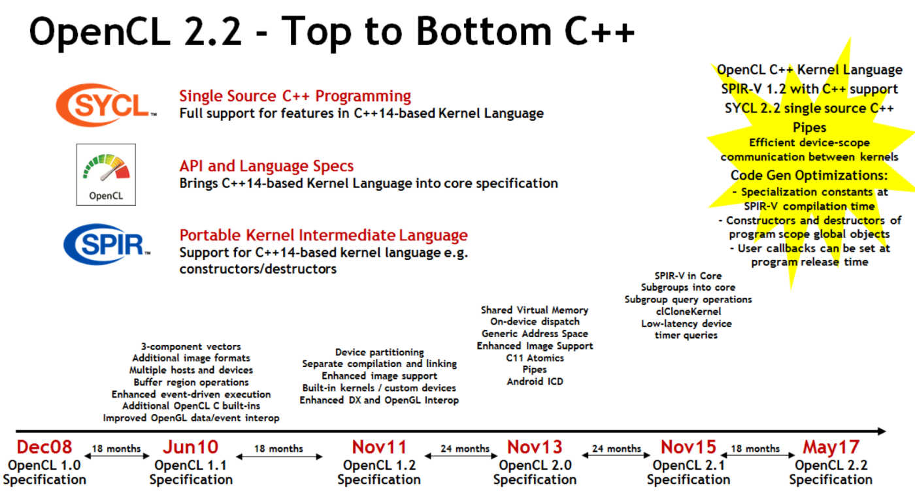
Introduction
History
OpenCL Board
OpenCL Overview
OpenCL Examples
Source: www.khronos.org/opencl
Notes:
SPIR: Standard Portable Intermediate Representation.
SYCL: Pronounced Sickle, increases the portability of OpenCL. It provides templates and libraries (like STL for C++).

Slide 16
Introduction
History
OpenCL Board
OpenCL Overview
OpenCL Examples
Source: www.khronos.org/opencl
Notes:
SPIR: Standard Portable Intermediate Representation.

Slide 17
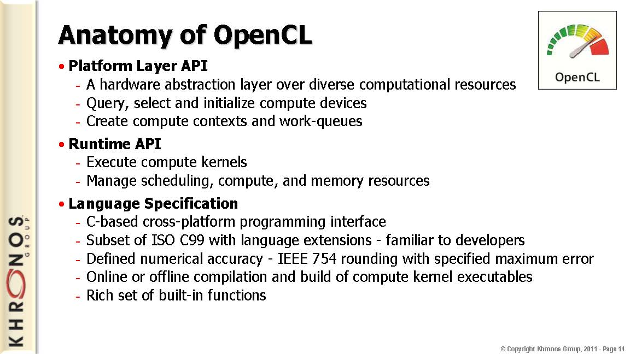
Introduction
History
OpenCL Board
OpenCL Overview
OpenCL Examples

Slide 18
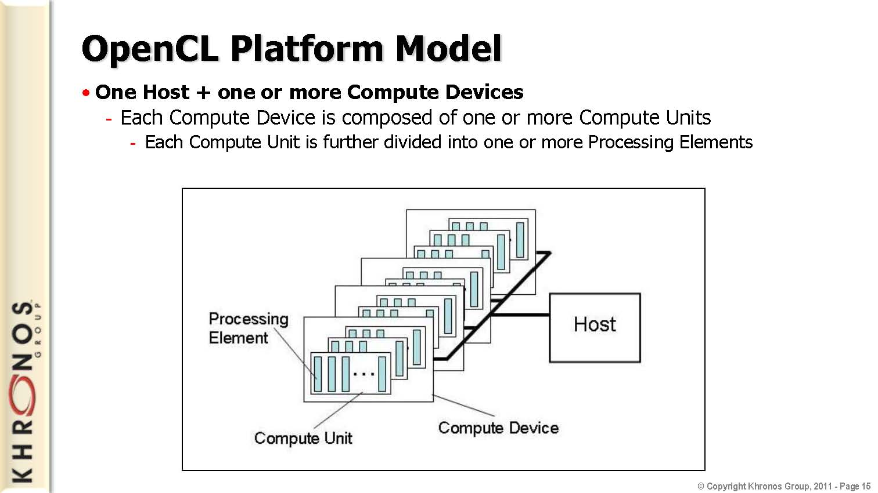
Introduction
History
OpenCL Board
OpenCL Overview
OpenCL Examples

Slide 19
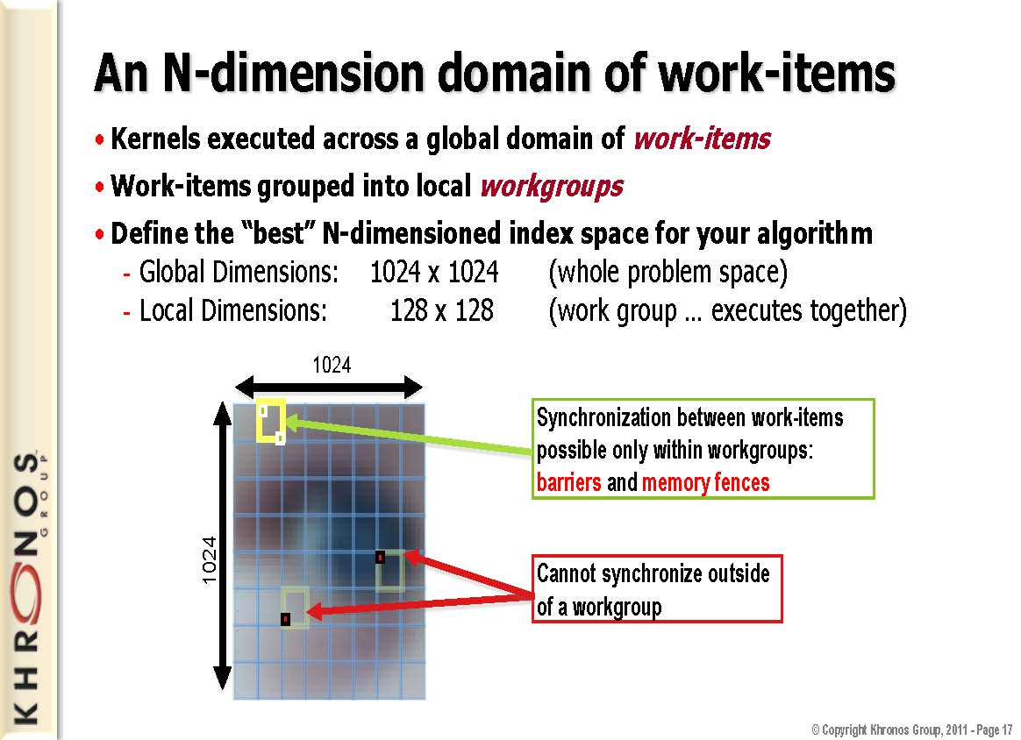
Introduction
History
OpenCL Board
OpenCL Overview
OpenCL Examples

Slide 20
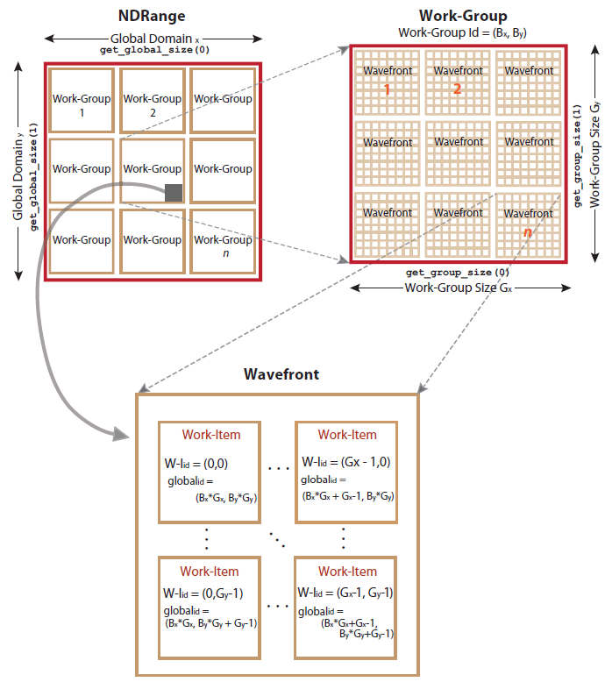
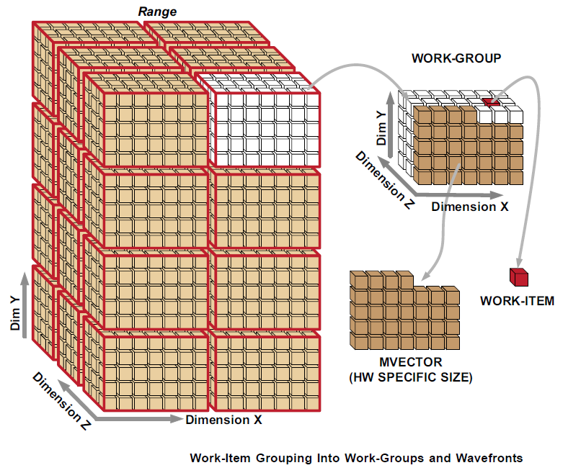
Introduction
History
OpenCL Board
OpenCL Overview
OpenCL Examples
AMD Accelerated Parallel Processing OpenCL July 2012
Notes:
Wavefronts and work-groups are two concepts relating to compute kernels that provide data-parallel granularity. A wavefront executes a number of work-items in lock step relative to each other. Sixteen work-items are execute in parallel across the vector unit, and the whole wavefront is covered over four clock cycles.
It is the lowest level that flow control can affect. This means that if two work-items inside of a wavefront go divergent paths of flow control, all work-items in the wavefront go to both paths of flow control.
Grouping is a higher-level granularity of data parallelism that is enforced in software, not hardware. Synchronization points in a kernel guarantee that all work-items in a work-group reach that point (barrier) in the code before the next statement is executed.
Work-groups are composed of wavefronts. Best performance is attained when the group size is an integer multiple of the wavefront size.

Slide 21
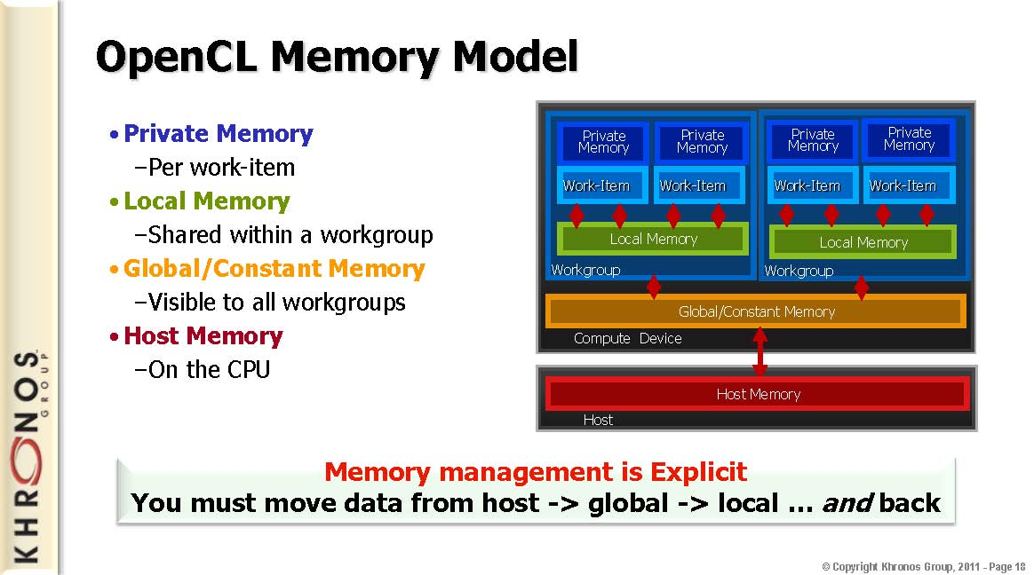
Introduction
History
OpenCL Board
OpenCL Overview
OpenCL Examples
Notes:
Private Mem: O(10) words/WI
Local Mem: O(1-10) Kbytes/Work Group
Global Mem: O(1-10) Gbytes
Const Mem: O(10-100) Kbytes
Host Mem: GBytes

Slide 22
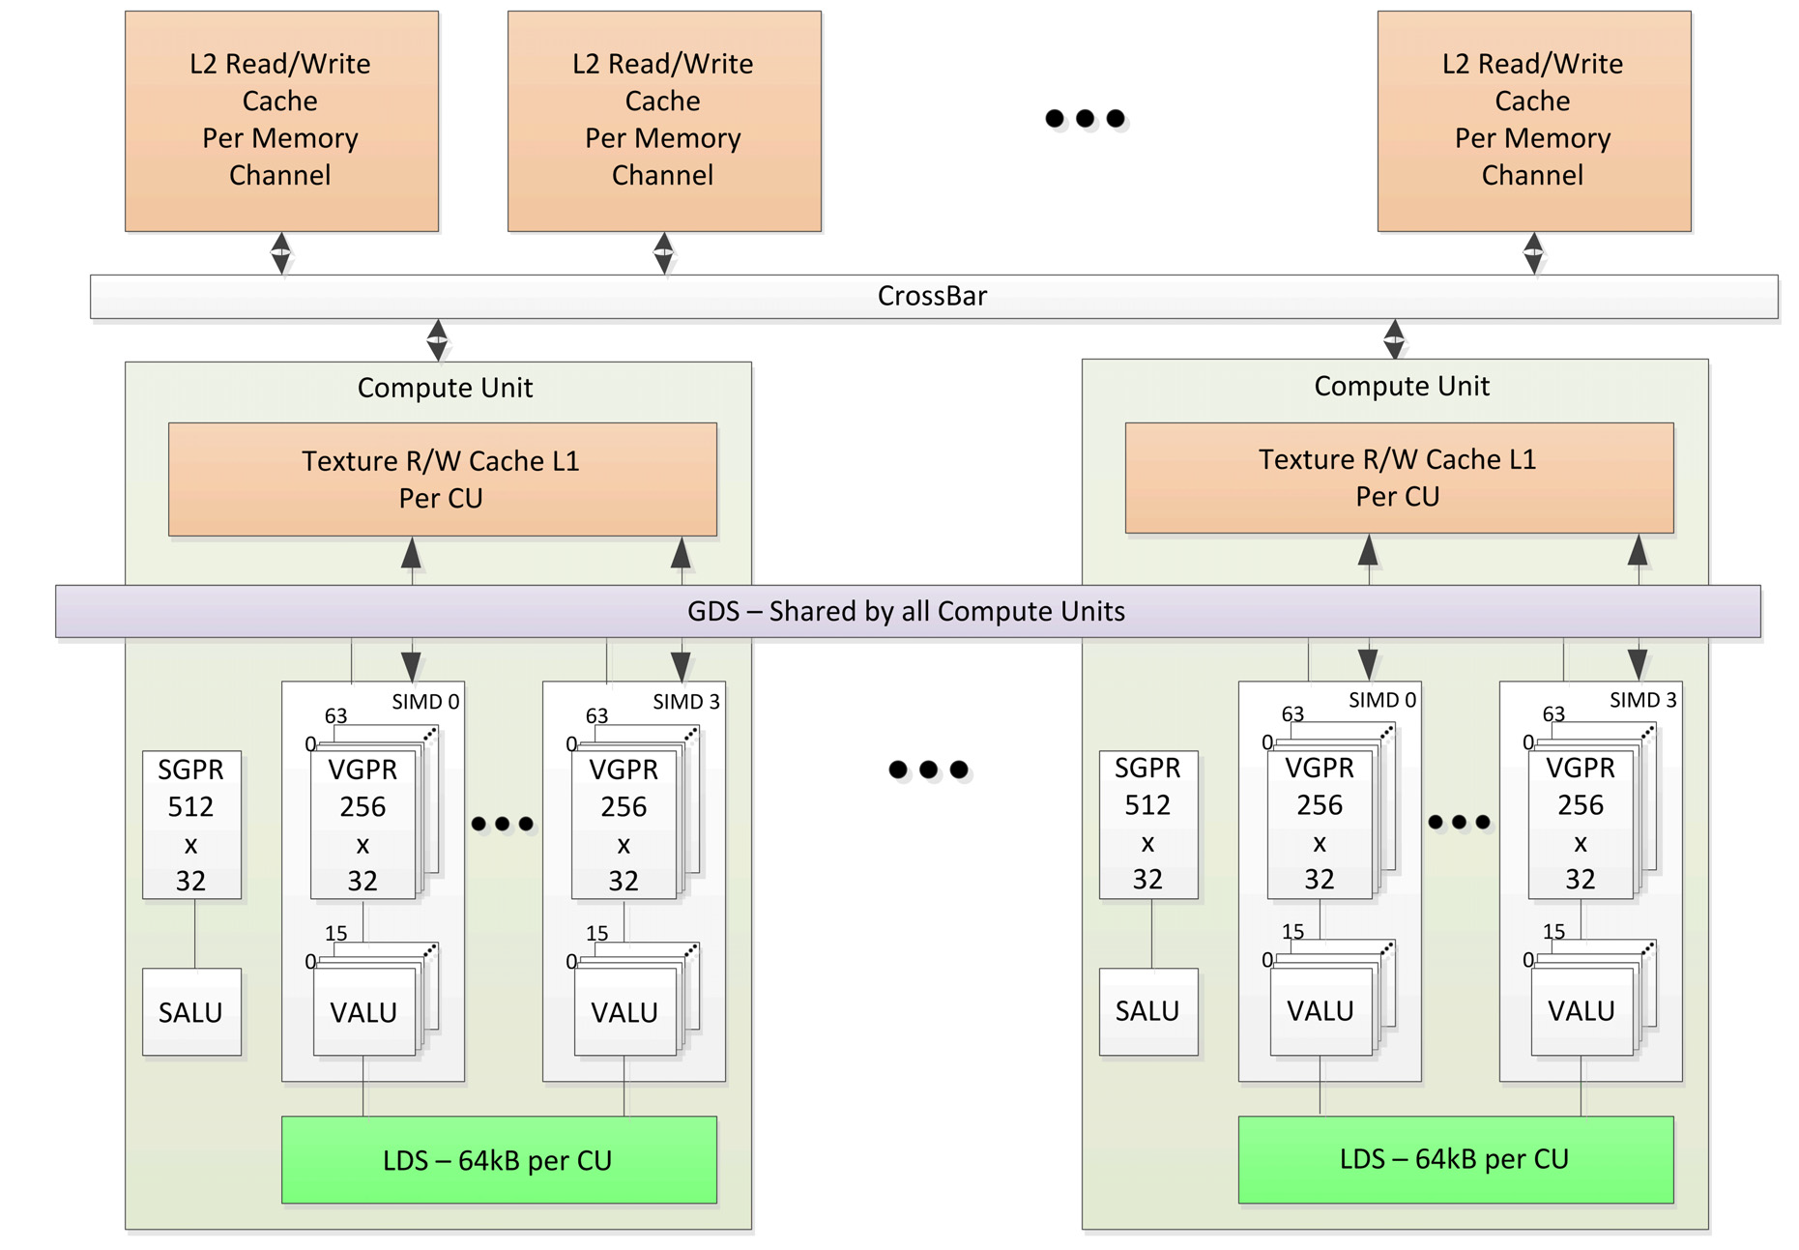
Introduction
History
OpenCL Board
OpenCL Overview
OpenCL Examples
Sothern Islands Memory Hierarchy
AMD Southern Islands Instruction Set Architecture, Aug 2012

Slide 23
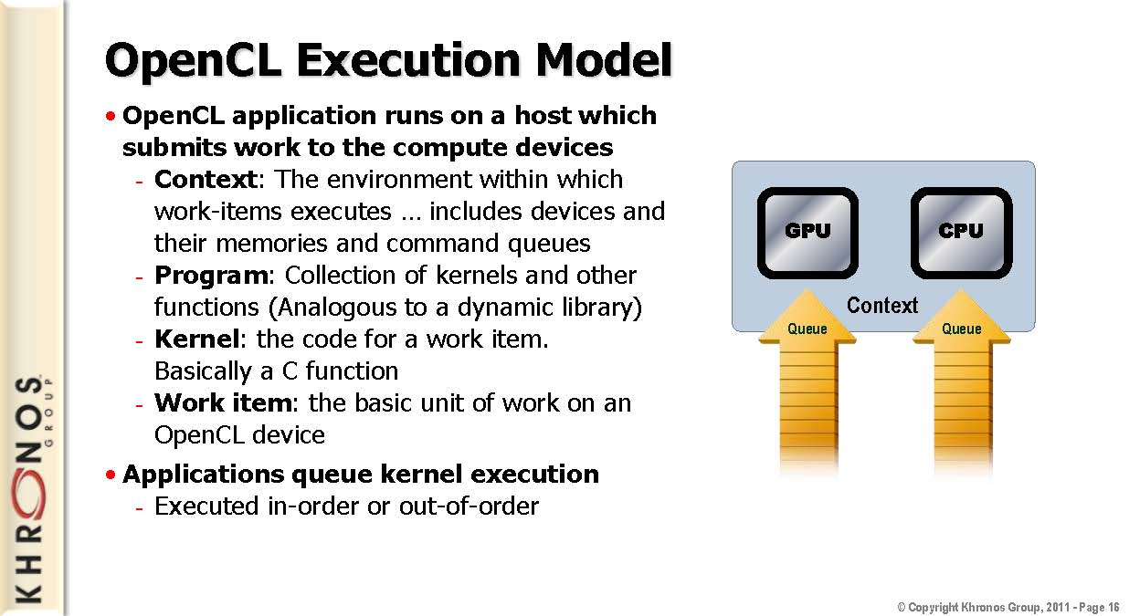
Introduction
History
OpenCL Board
OpenCL Overview
OpenCL Examples

Slide 24
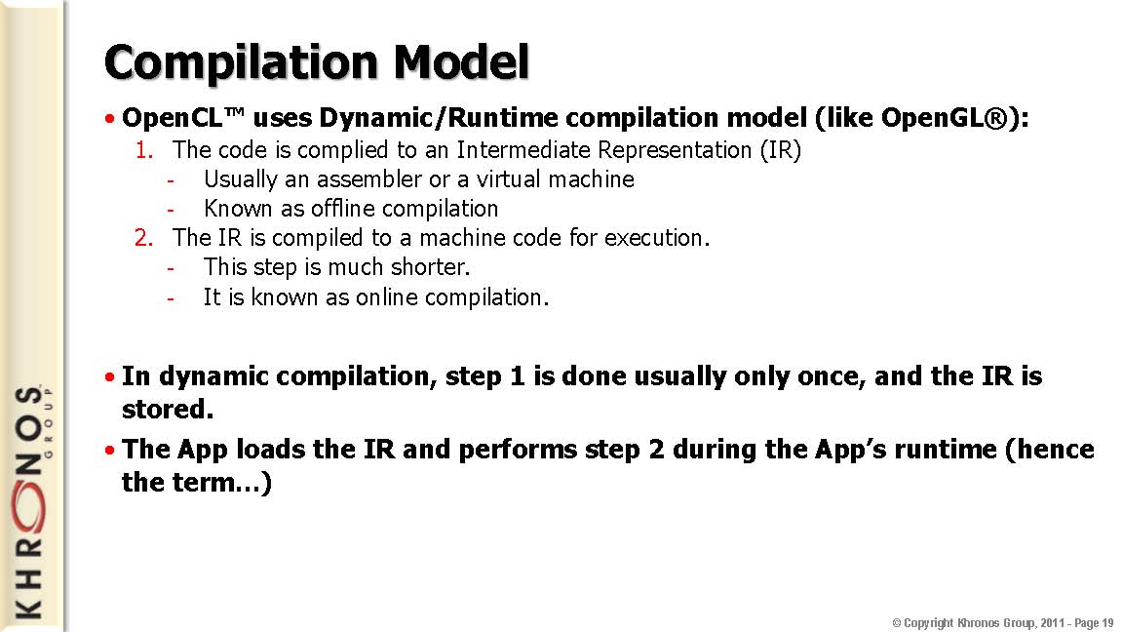
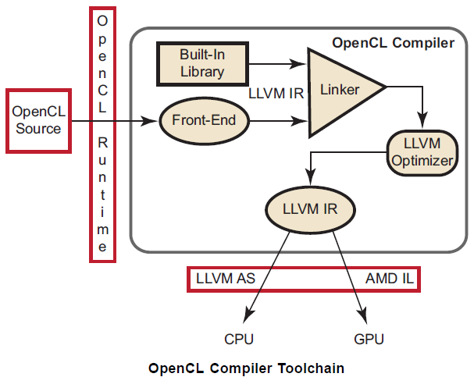
Introduction
History
OpenCL Board
OpenCL Overview
OpenCL Examples
Notes:
The compiler tool-chain provides a common framework for both CPUs and GPUs, sharing the front-end and some high-level compiler transformations. The kernels are compiled by the OpenCL compiler to either CPU binaries or GPU binaries, depending on the target device.
For CPU processing, the OpenCL runtime uses the LLVM AS to generate x86 binaries. The OpenCL runtime automatically determines the number of processing elements, or cores, present in the CPU and distributes the OpenCL kernel between them.
For GPU processing, the OpenCL runtime post-processes the incomplete AMD IL from the OpenCL compiler and turns it into complete AMD IL. This adds macros (from a macro database, similar to the built-in library) specific to the GPU. The OpenCL Runtime layer then removes unneeded functions and passes the complete IL to the CAL compiler for compilation to GPU-specific binaries.

Slide 25
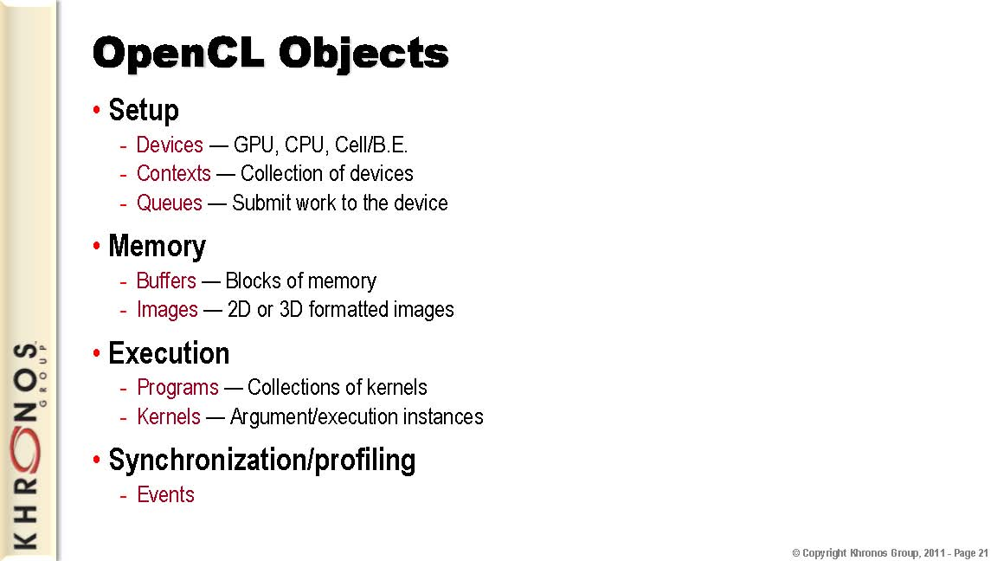
Introduction
History
OpenCL Board
OpenCL Overview
OpenCL Examples

Slide 26
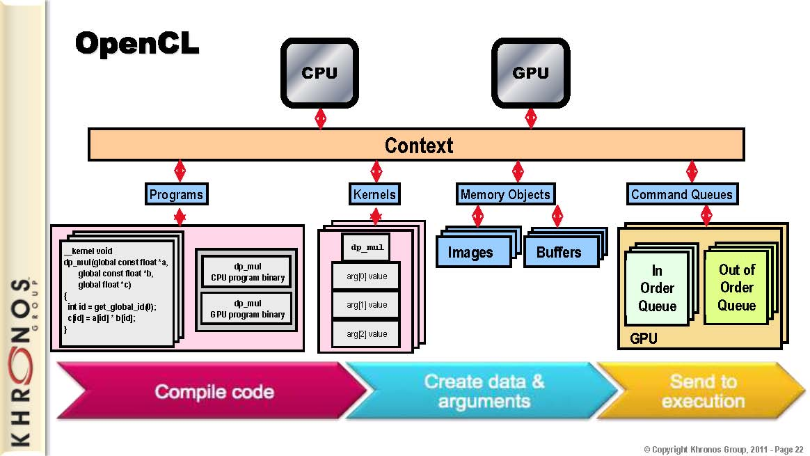
Introduction
History
OpenCL Board
OpenCL Overview
OpenCL Examples
AMD Accelerated Parallel Processing OpenCL July 2012

Slide 27
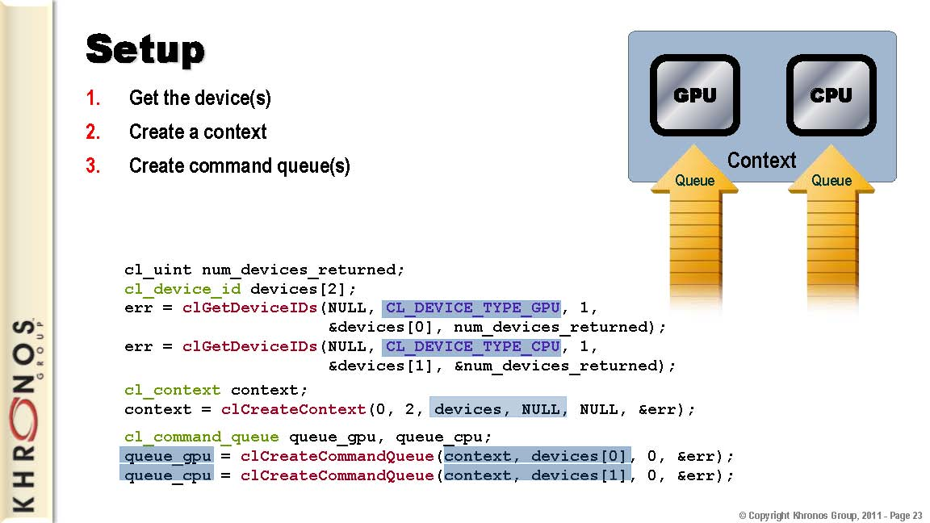
Introduction
History
OpenCL Board
OpenCL Overview
OpenCL Examples

Slide 28
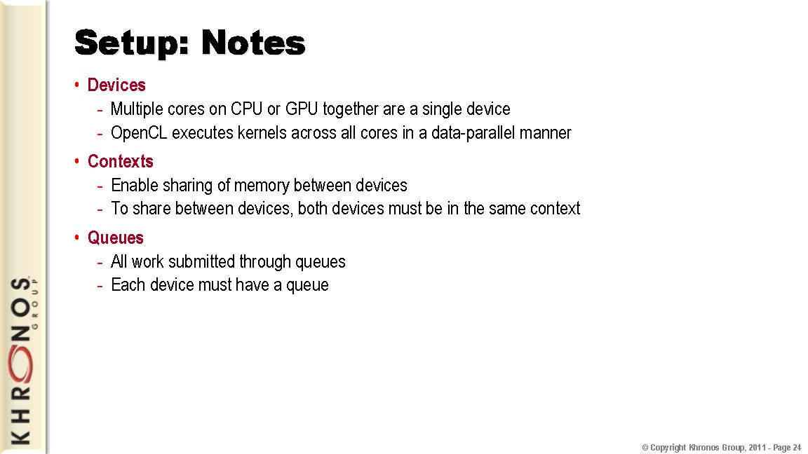
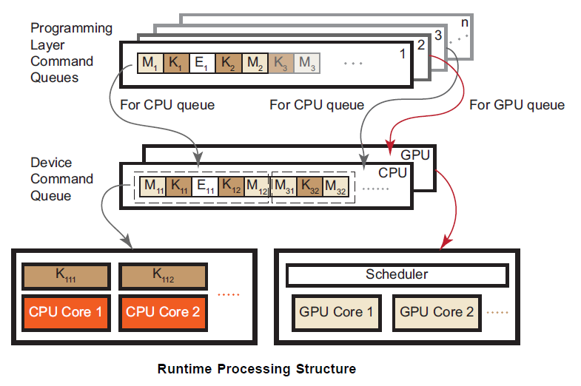
Introduction
History
OpenCL Board
OpenCL Overview
OpenCL Examples
AMD Accelerated Parallel Processing OpenCL July 2012
Notes:
At run time, the application can create multiple command queues (some in libraries, for different components of the application, etc.). These queues are muxed into one queue per device type. The figure shows command queues 1 and 3 merged into one CPU device queue (blue arrows); command queue 2 (and possibly others) are merged into the GPU device queue (red arrow). The device queue then schedules work onto the multiple compute resources present in the device. Here, K = kernel commands, M = memory commands, and E = event commands.

Slide 29
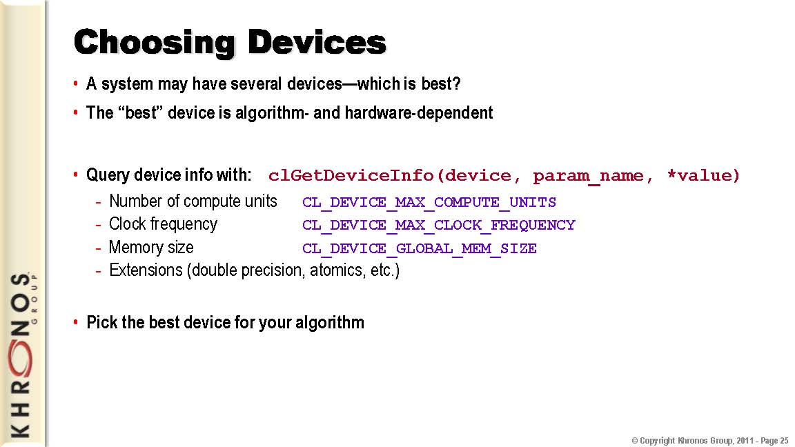
Introduction
History
OpenCL Board
OpenCL Overview
OpenCL Examples

Slide 30
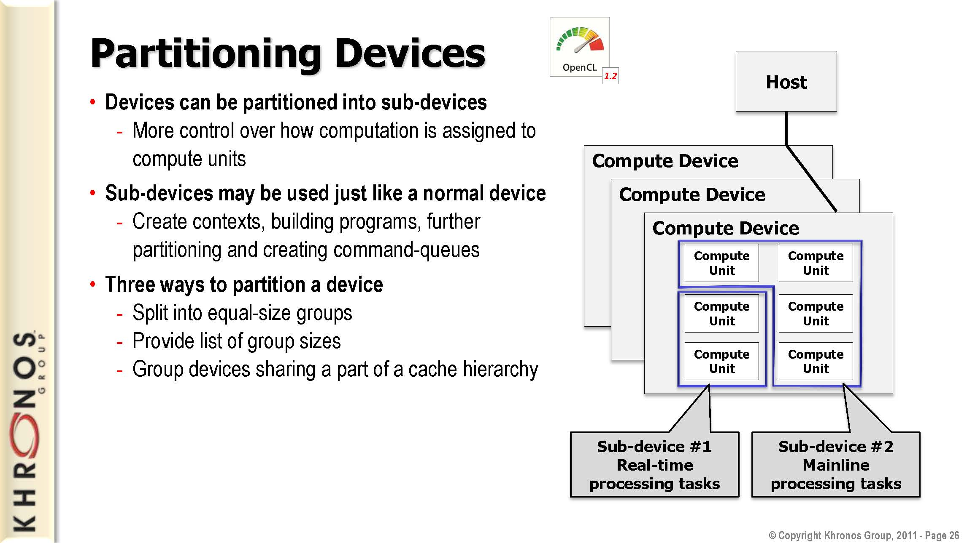
Introduction
History
OpenCL Board
OpenCL Overview
OpenCL Examples

Slide 31
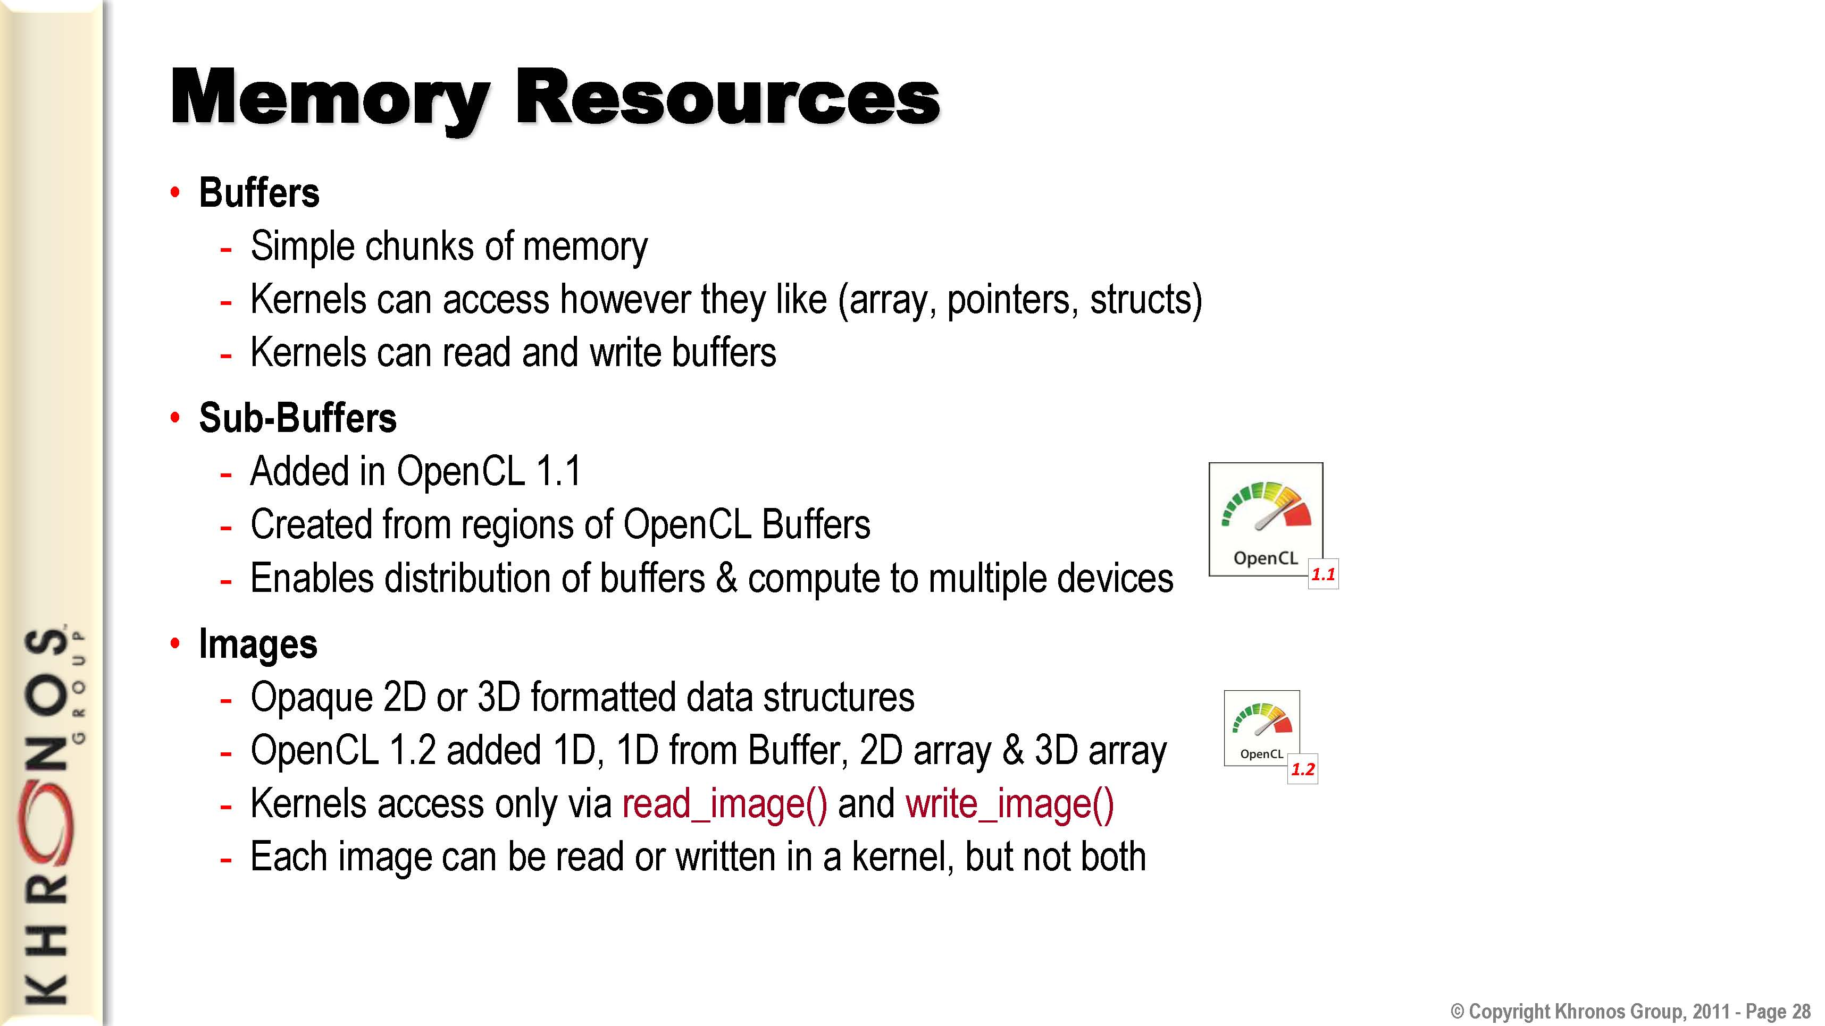
Introduction
History
OpenCL Board
OpenCL Overview
OpenCL Examples

Slide 32
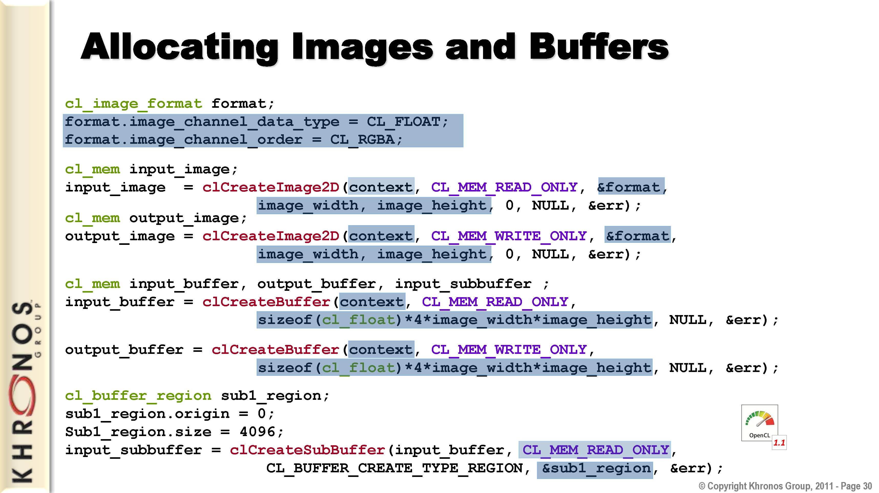
Introduction
History
OpenCL Board
OpenCL Overview
OpenCL Examples

Slide 33
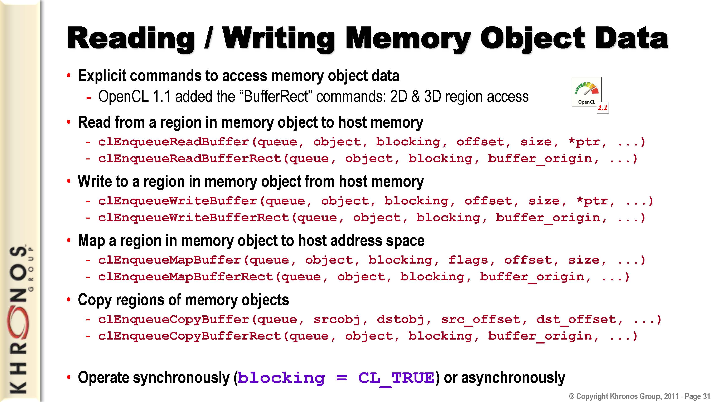
Introduction
History
OpenCL Board
OpenCL Overview
OpenCL Examples

Slide 34
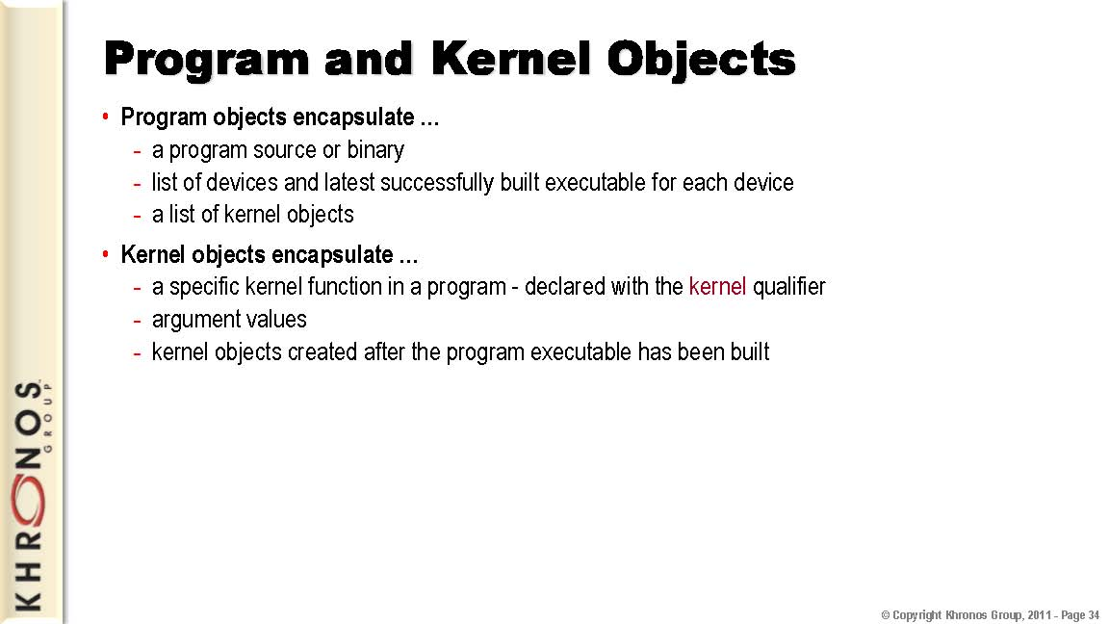
Introduction
History
OpenCL Board
OpenCL Overview
OpenCL Examples

Slide 35
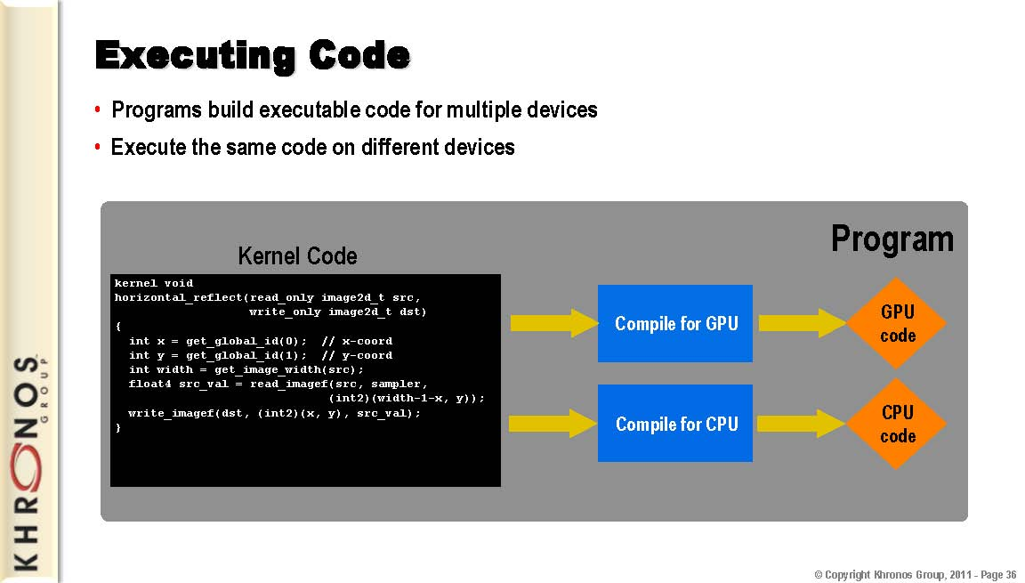
Introduction
History
OpenCL Board
OpenCL Overview
OpenCL Examples

Slide 36
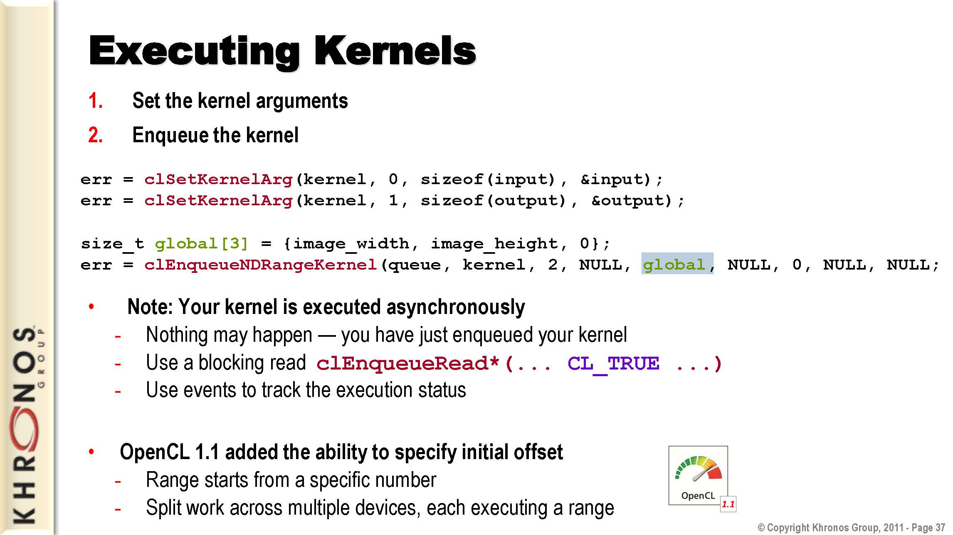
Introduction
History
OpenCL Board
OpenCL Overview
OpenCL Examples

Slide 37
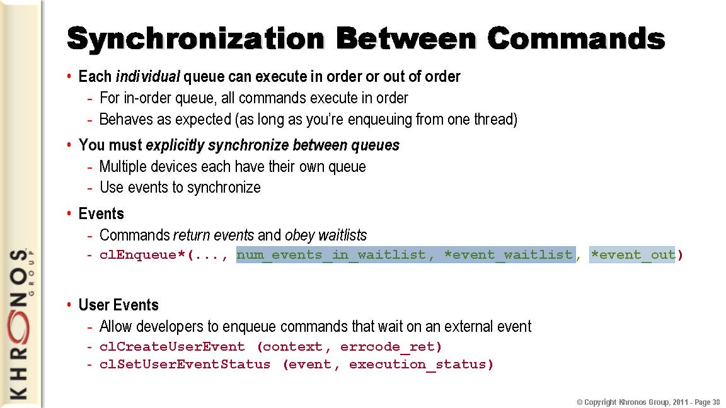
Introduction
History
OpenCL Board
OpenCL Overview
OpenCL Examples

Slide 38
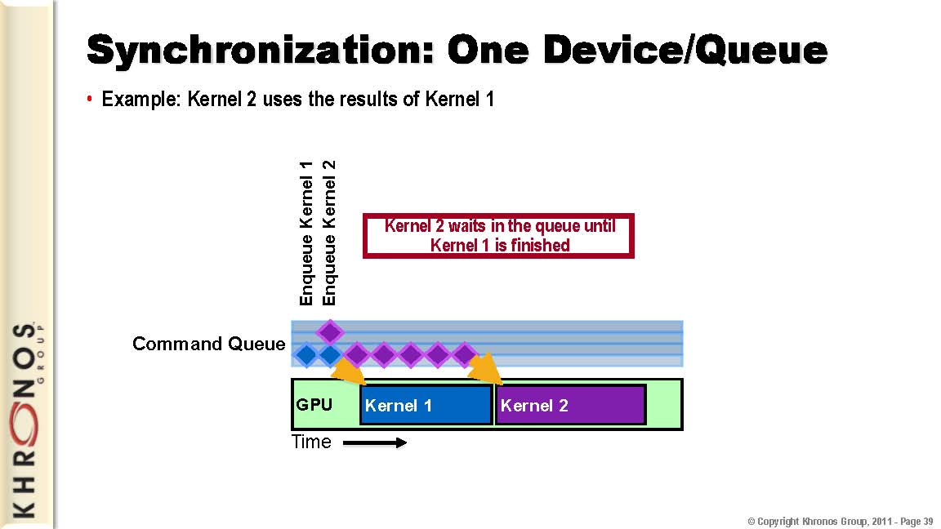
Introduction
History
OpenCL Board
OpenCL Overview
OpenCL Examples

Slide 39
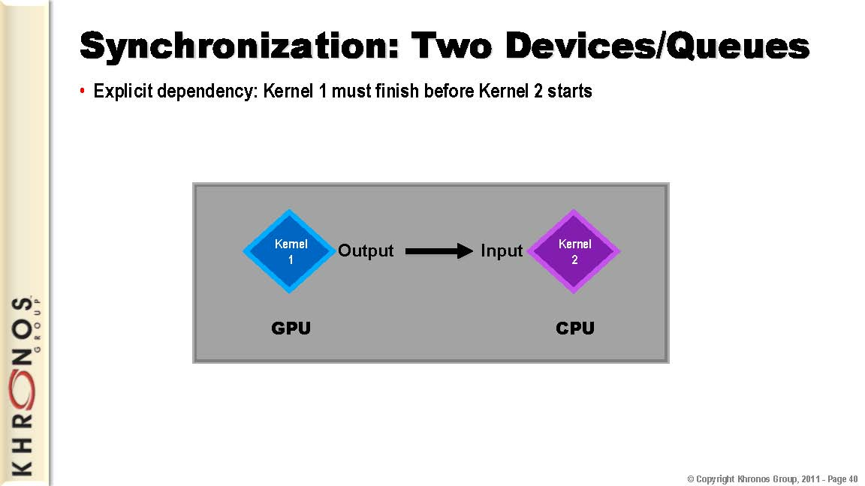
Introduction
History
OpenCL Board
OpenCL Overview
OpenCL Examples

Slide 40
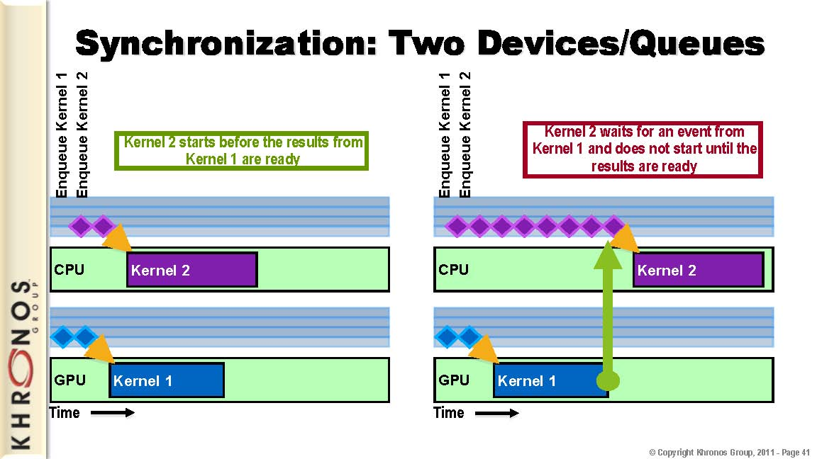
Introduction
History
OpenCL Board
OpenCL Overview
OpenCL Examples

Slide 41
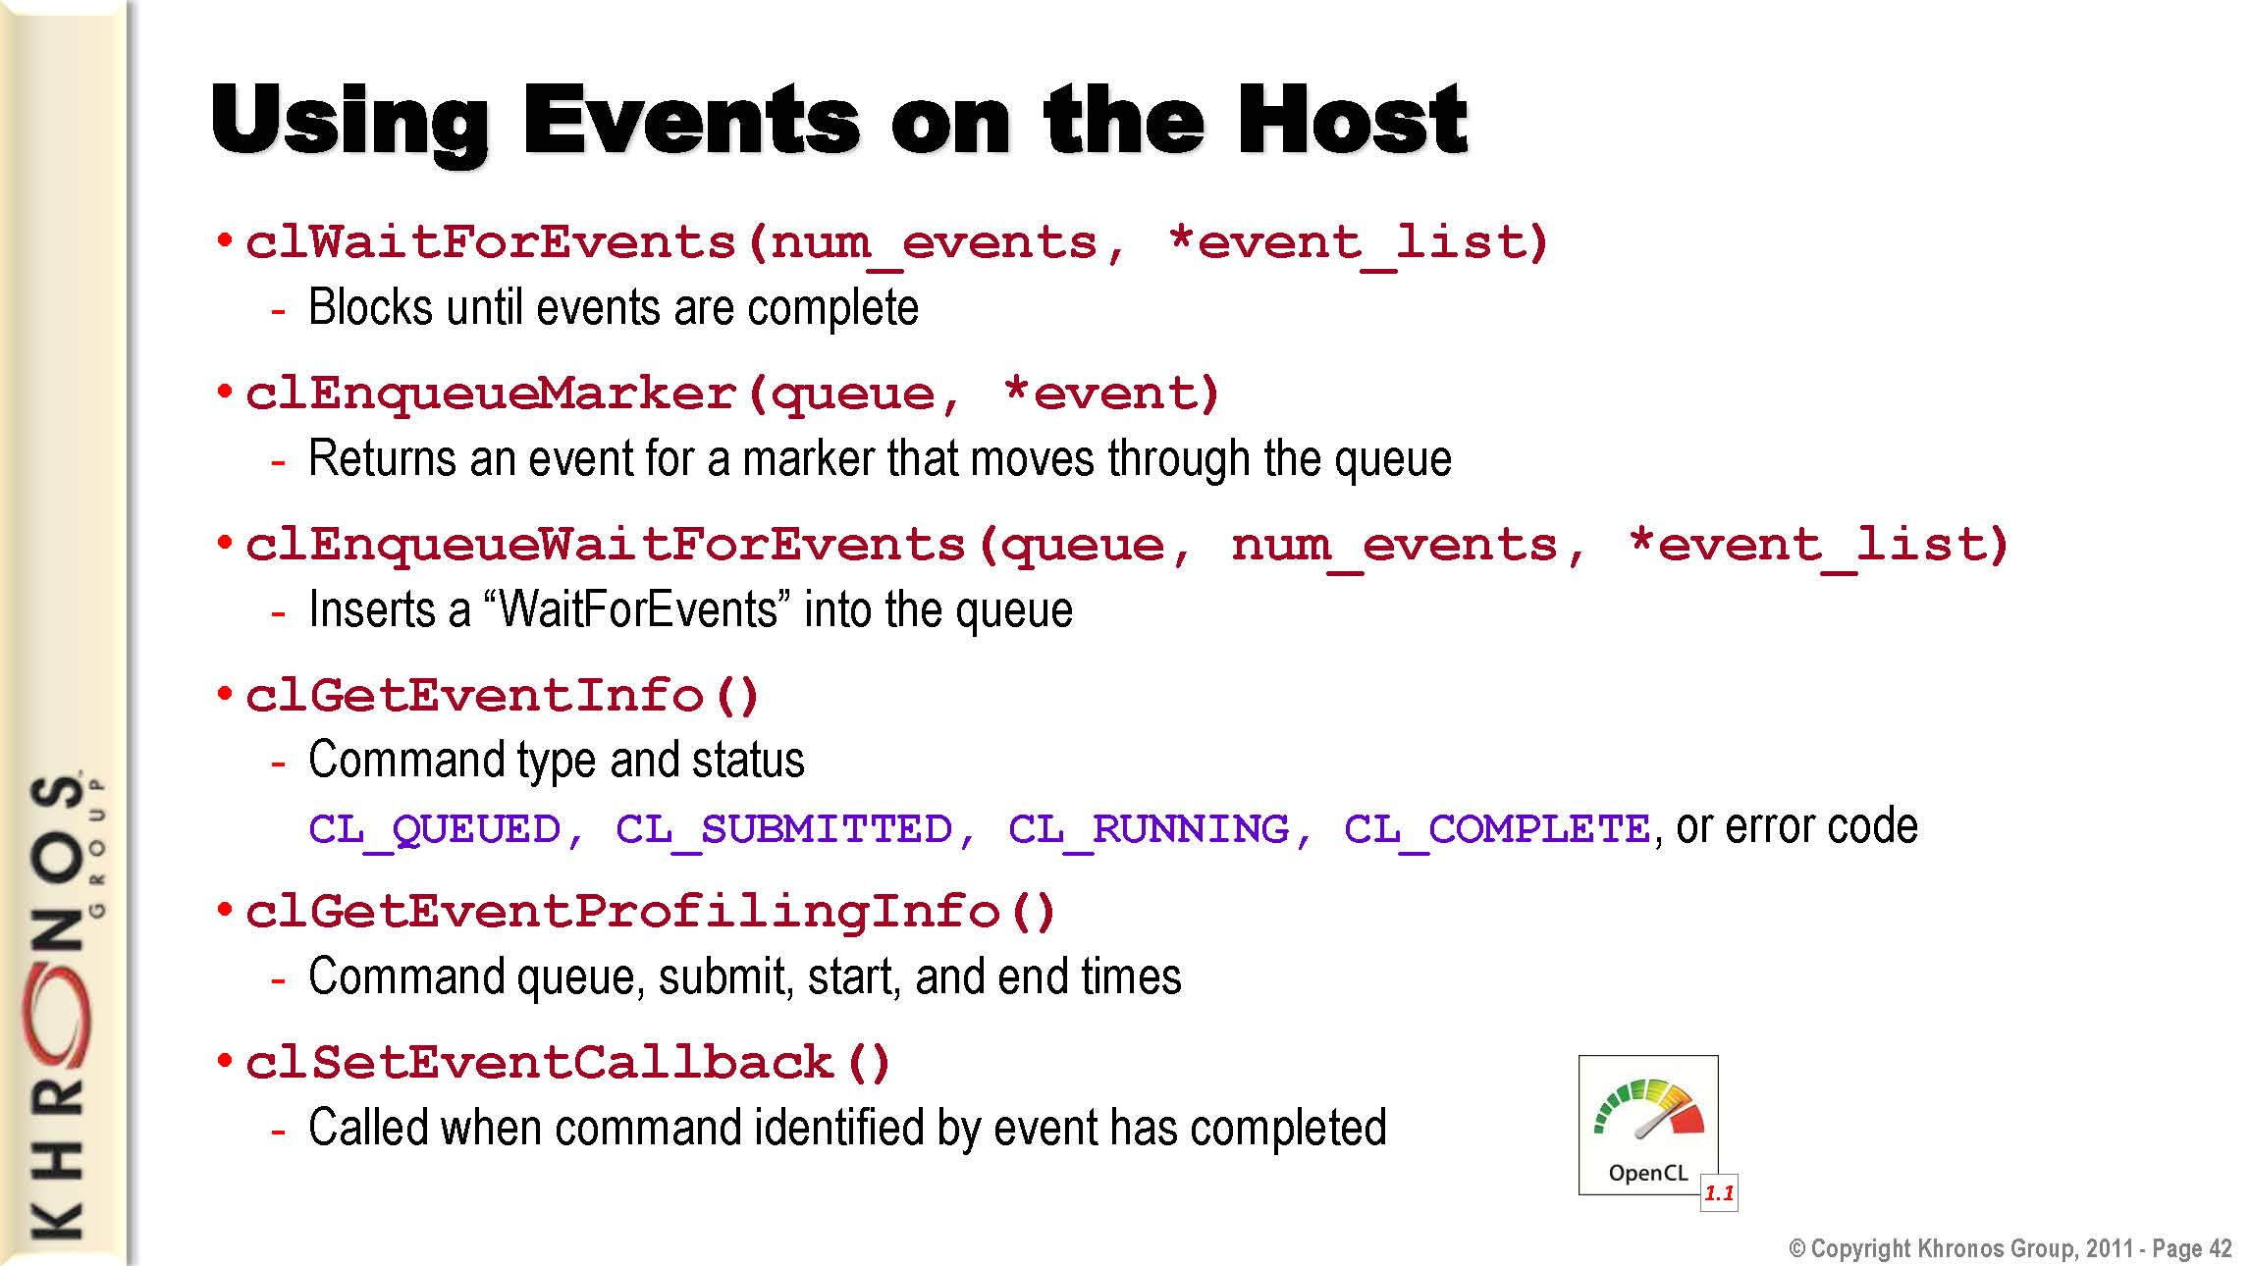
Introduction
History
OpenCL Board
OpenCL Overview
OpenCL Examples

Slide 42
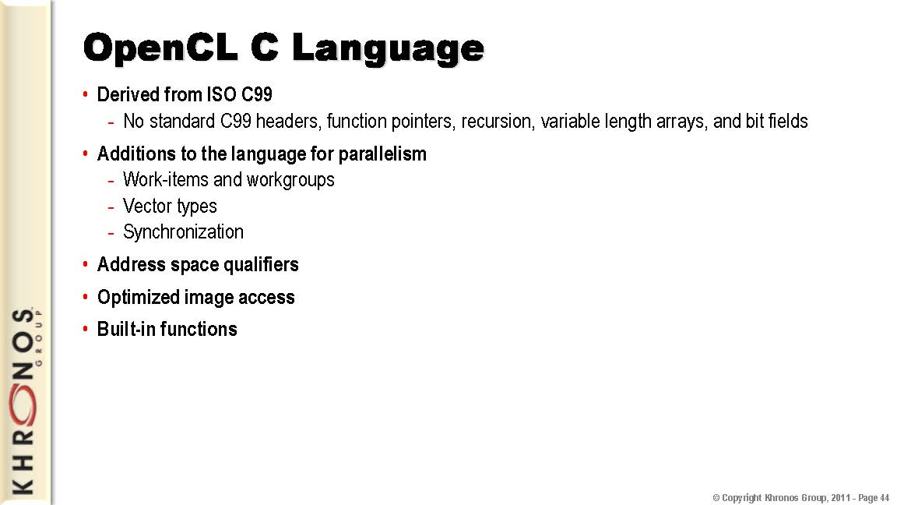
Introduction
History
OpenCL Board
OpenCL Overview
OpenCL Examples

Slide 43
Introduction
History
OpenCL Board
OpenCL Overview
OpenCL Examples
Kernel Functions Restrictions:
Arguments to kernel functions that are pointers must use the global, constant, or local qualifier.
An argument to a kernel function cannot be declared as a pointer to a pointer(s).
Arguments to kernel functions cannot be declared with the following built-in types: bool, half, size_t, ptrdiff_t, intptr_t, uintptr_t, or event_t.
The return type for a kernel function must be void.
Arguments to kernel functions that are declared to be a struct cannot pass OpenCL objects (such as buffers, images) as elements of the struct.
Bit field struct members are not supported.
Variable-length arrays and structures with flexible (or unsized) arrays are not supported.
Variadic macros and functions are not supported.
The extern, static, auto, and register storage class specifiers are not supported.
Predefined identifiers such as __func__ are not supported.
The library functions defined in the C99 standard headers—assert.h, ctype.h, complex.h, errno.h, fenv.h, float.h, inttypes.h, limits.h, locale.h, setjmp.h, signal.h, stdarg.h, stdio.h, stdlib.h, string.h, tgmath.h, time.h, wchar.h, and wctype.h—are not available and cannot be included by a program.

Slide 44
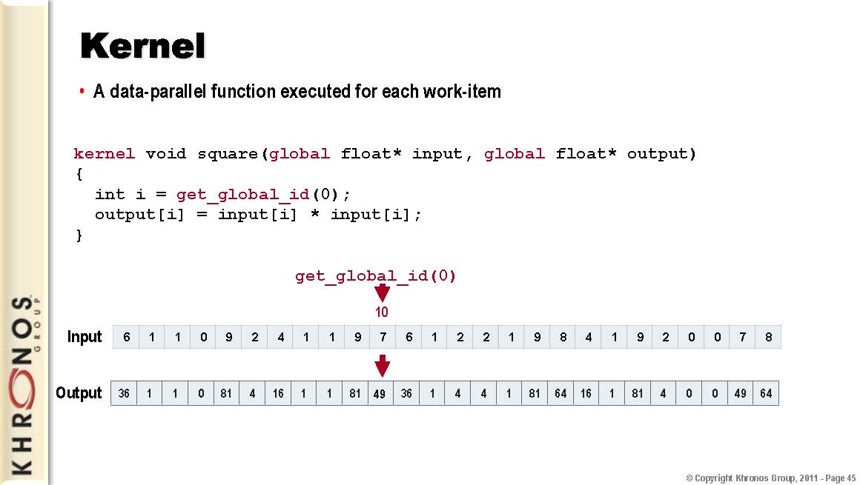
Introduction
History
OpenCL Board
OpenCL Overview
OpenCL Examples

Slide 45
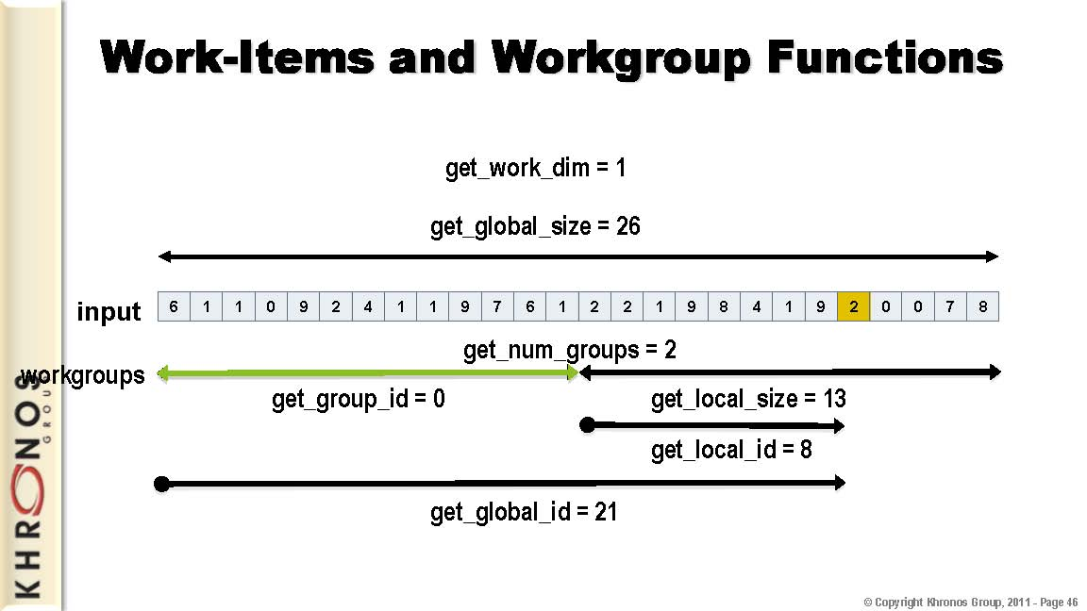
Introduction
History
OpenCL Board
OpenCL Overview
OpenCL Examples

Slide 46
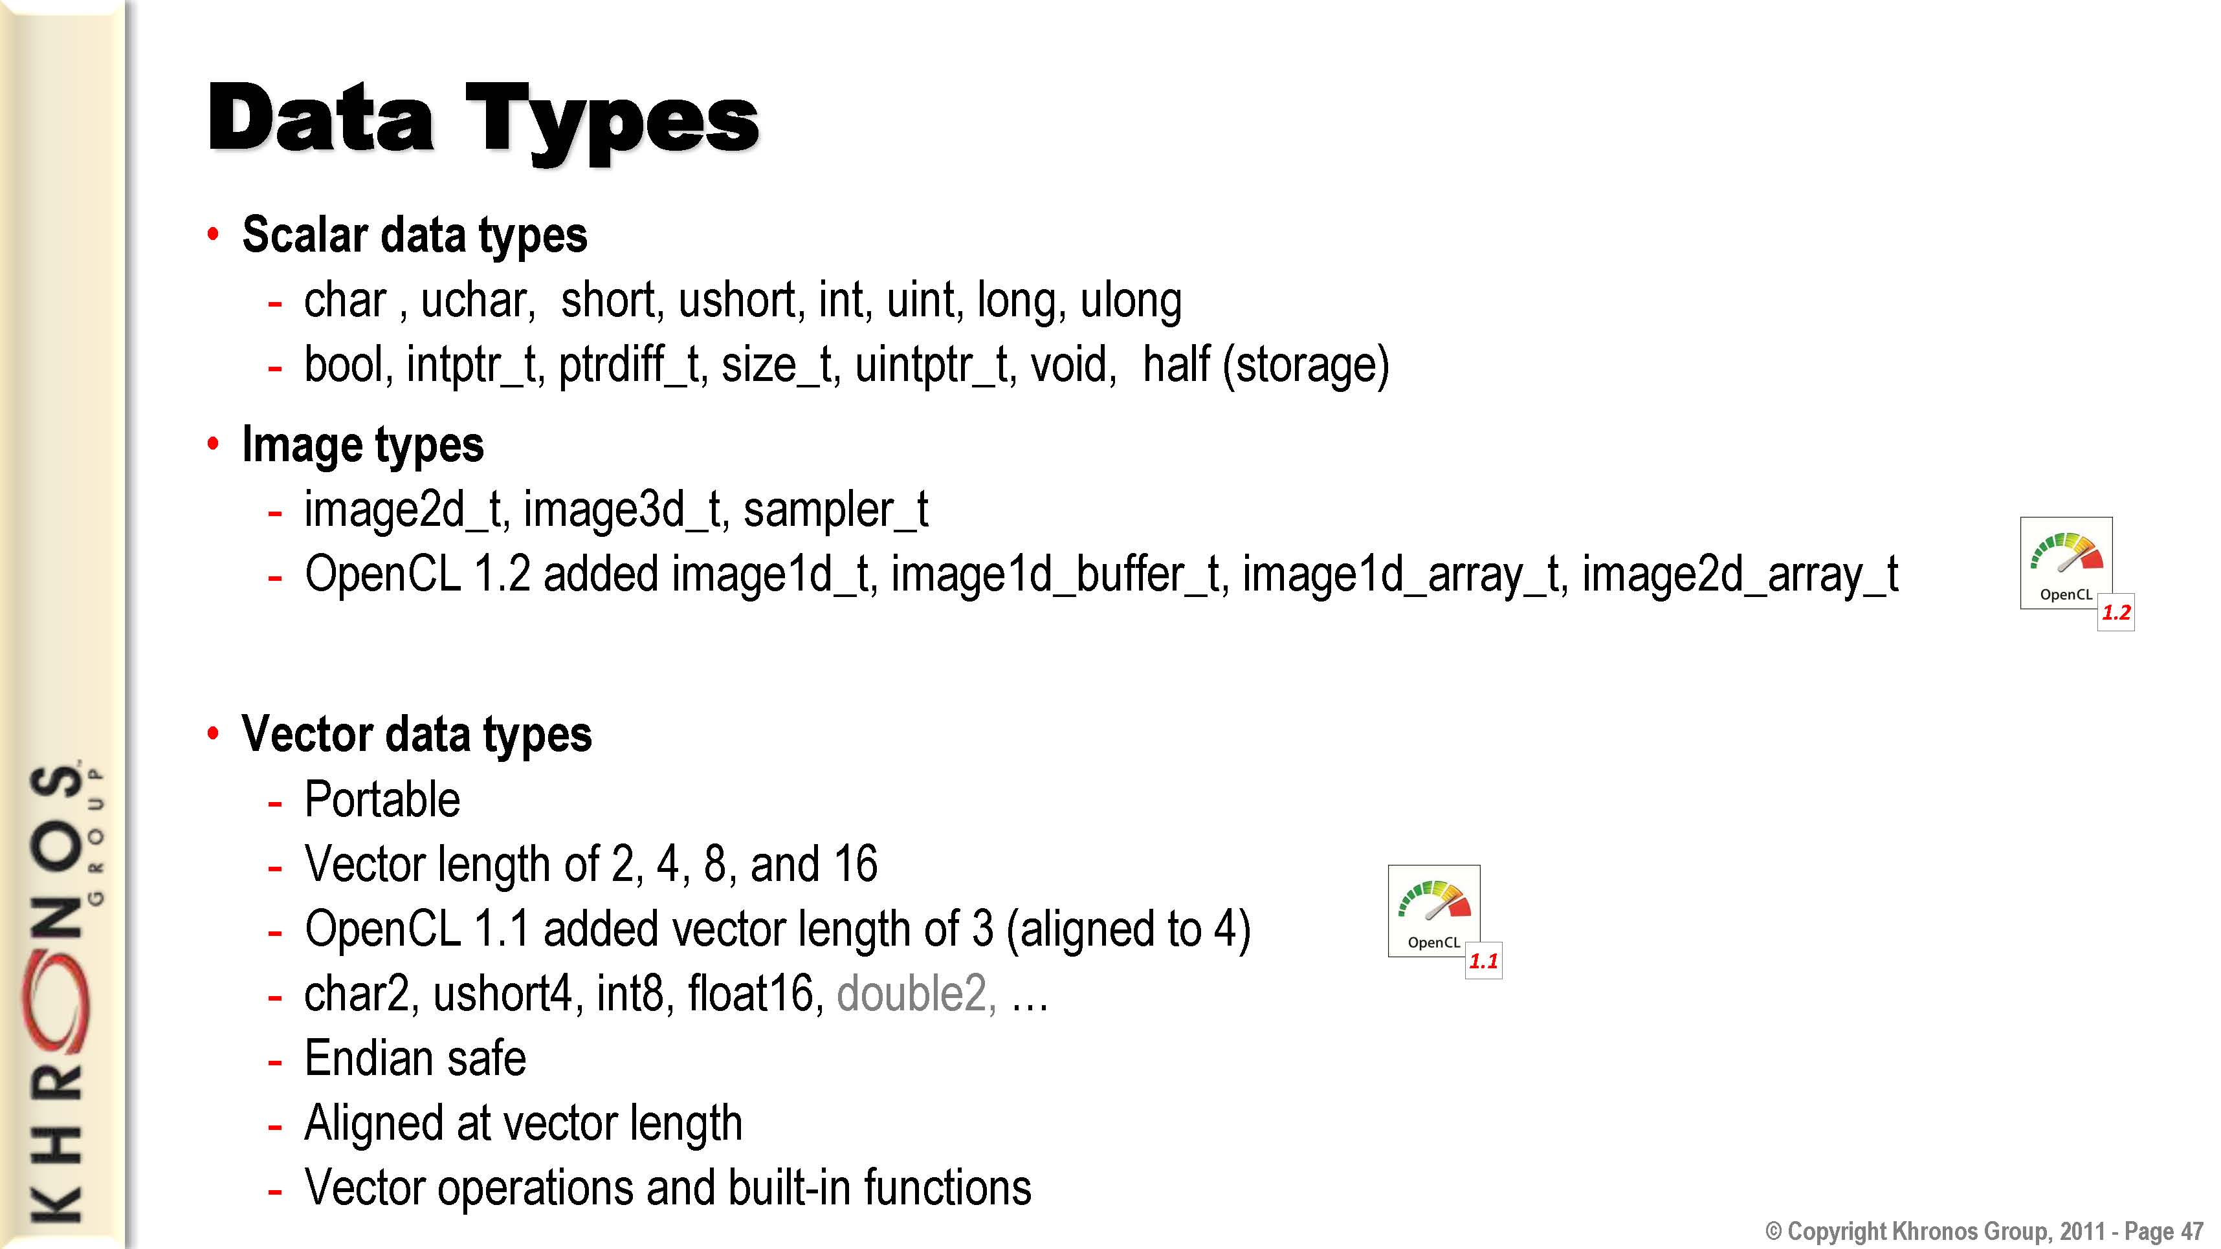
Introduction
History
OpenCL Board
OpenCL Overview
OpenCL Examples

Slide 47
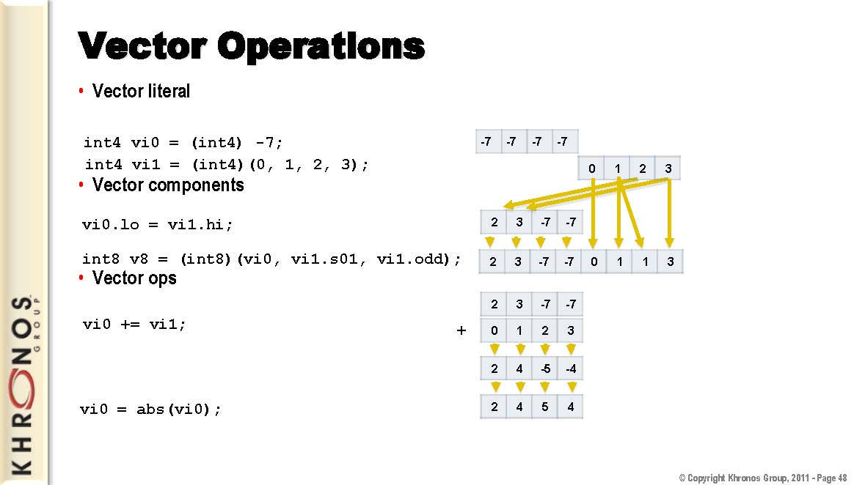
Introduction
History
OpenCL Board
OpenCL Overview
OpenCL Examples

Slide 48
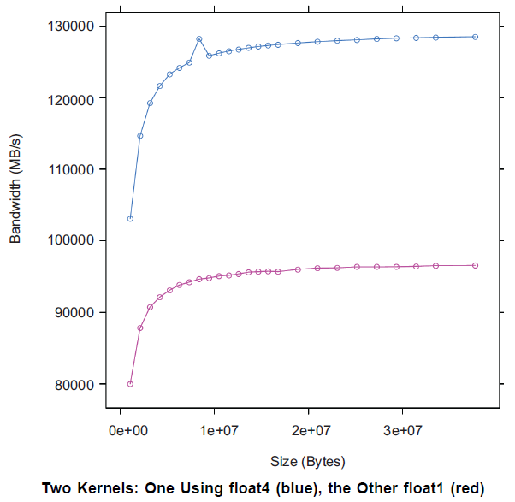
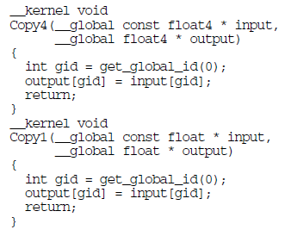
Introduction
History
OpenCL Board
OpenCL Overview
OpenCL Examples
AMD Accelerated Parallel Processing OpenCL July 2012
Notes:
The internal memory paths support 128-bit transfers. This allows for greater bandwidth when transferring data in float4 format. In certain cases (when the data size is a multiple of four), float4 operations are faster.

Slide 49
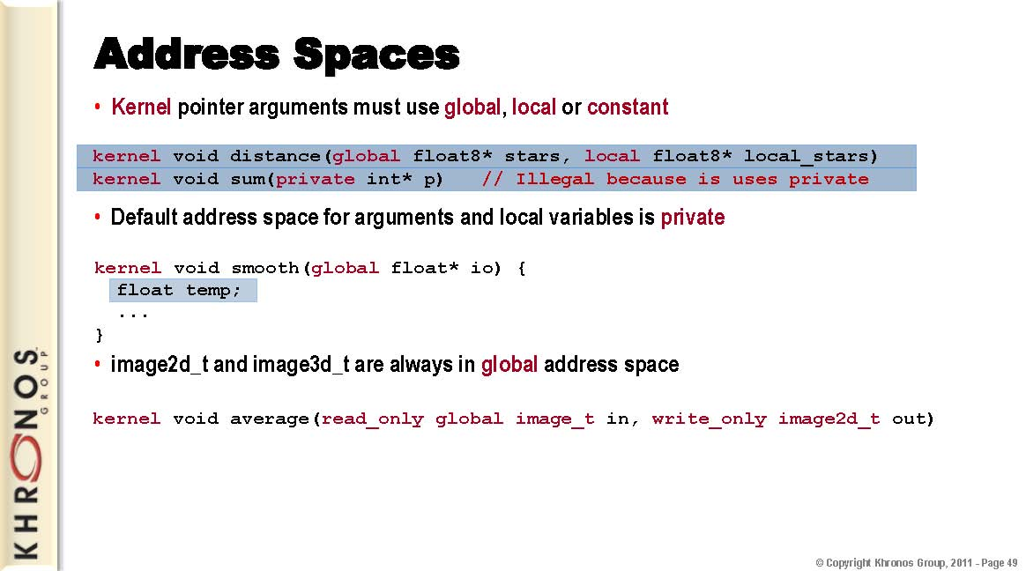
Introduction
History
OpenCL Board
OpenCL Overview
OpenCL Examples

Slide 50
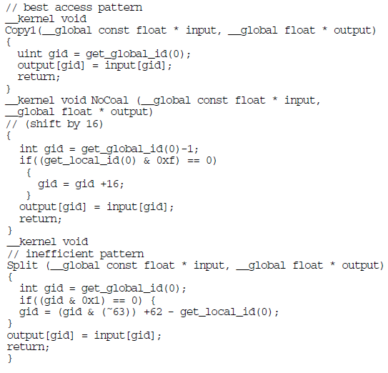
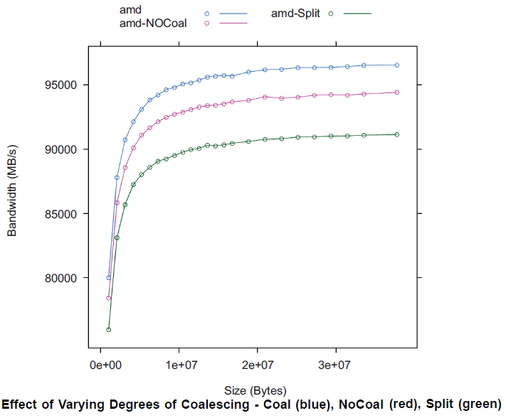
Introduction
History
OpenCL Board
OpenCL Overview
OpenCL Examples
AMD Accelerated Parallel Processing OpenCL July 2012
Notes:
The first kernel Copy1 maximizes coalesced writes: work-item k writes to address k. The second kernel writes a shifted pattern: In each quarter-wavefront of 16 work-items, work-item k writes to address k-1, except the first work-item in each quarter-wavefront writes to address k+16. There is not enough order here to coalesce on some other vendor machines. Finally, the third kernel has work-item
k write to address k when k is even, and write address 63-k when k is odd. This pattern never coalesces.

Slide 51
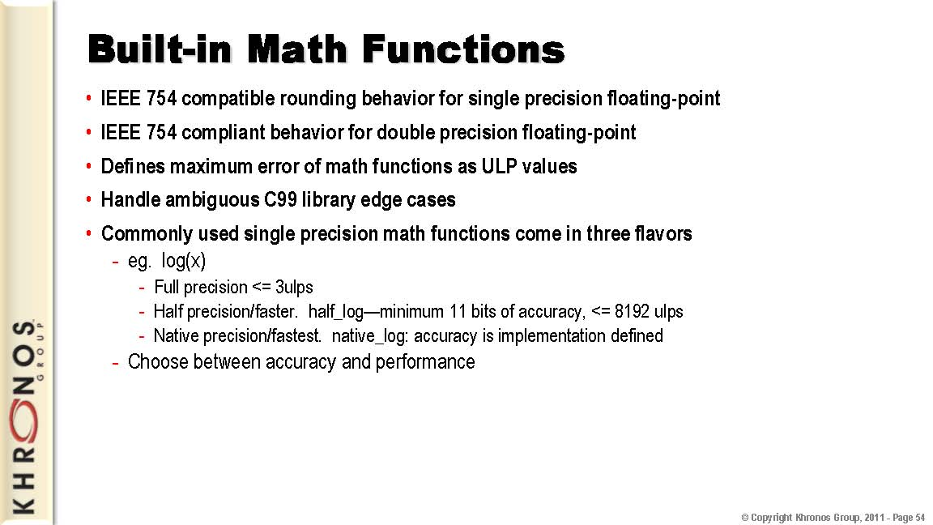
Introduction
History
OpenCL Board
OpenCL Overview
OpenCL Examples

Slide 52
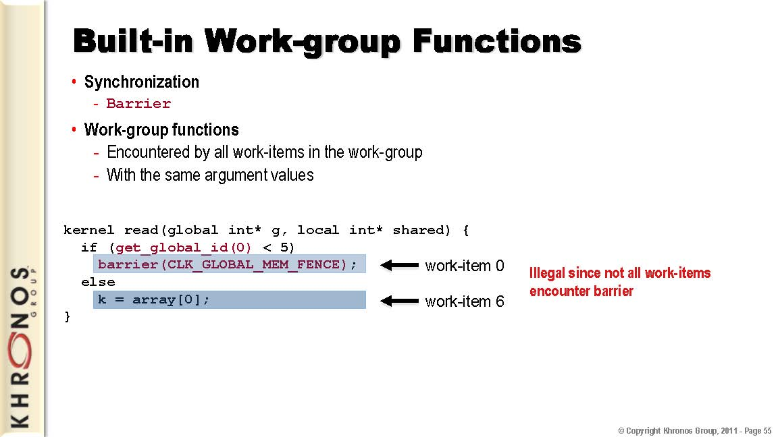
Introduction
History
OpenCL Board
OpenCL Overview
OpenCL Examples

Slide 53
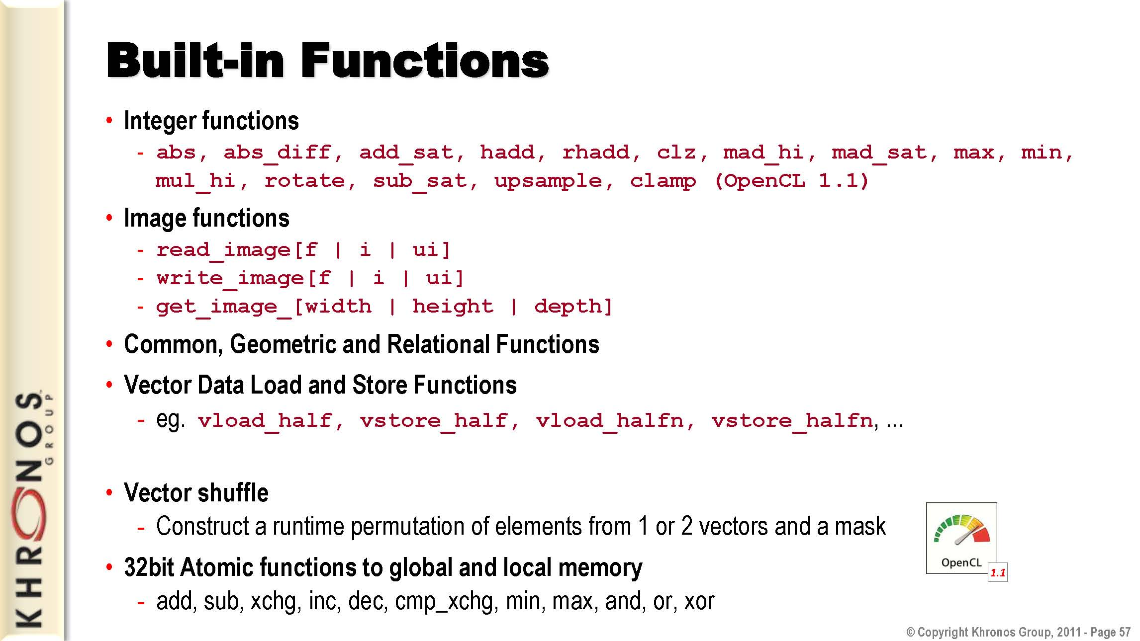
Introduction
History
OpenCL Board
OpenCL Overview
OpenCL Examples

Slide 54


History
OpenCL Board
OpenCL Overview
OpenCL Examples
AMD OpenCL Tools
Numerical Reduction
OpenCL In Action (Matthew Scarpino 2012)
Notes:
Numerical reduction adds the elements of an array and computes a single sum. In this section, we’re going to look closely at this algorithm and see how to implement it to add 2^20. With a single work-item, this can be accomplished as:
By default, the host application generates (1,048,576) work-items to execute this kernel. On AMD 5850 GPU, these items are combined into 4,096 work-groups, each containing 256 work items.
The addition procedure employed by each work-group requires log2(N) stages, where N is the number of input values and work-items. In the first stage, the N input values are added in pairs to produce N/2 results. The next stage adds the N/2 input values in pairs and produces N/4 results. This process continues until a single value remains. Figure shows the full process for a work-group where N = 8.

Slide 55



History
OpenCL Board
OpenCL Overview
OpenCL Examples
AMD OpenCL Tools
OpenCL In Action (Matthew Scarpino 2012)
Notes:
Listing 10.2 presents the code that implements the reduction procedure depicted in previous. This kernel accepts the following parameters:
Each work-item starts by transferring an element of input data to local memory B, and it’s important to see how this works. There are 2^20 work-items in total, one for each element in the input data array located in global memory. Because every global ID is unique, a work-item can read a unique element by accessing data[get_ global_id(0)]. In local memory, the partial sums array stores one float for each work-item in a workgroup.
Within a work-group, a work-item uses its local ID instead of its global ID. This is why the work-item writes the input float from data[get_global_id(0)] to the local memory position partial_sums[lid]. After the work-group’s input data is transferred to local memory, the actual reduction starts. In the first stage, only half of the work-group’s work-items take part. Each adds its corresponding element of partial_sums to an element half-way further in the array. The second and proceeding stages continue adding partial sums together in the manner shown in figure. After each stage, the barrier function forces each work-item to wait until every other work-item in the work-group has finished accessing local memory.
When the addition is finished, the work-item whose local ID equals 0 will place the final sum in global memory. More precisely, it transfers partial_sums[0] in local memory to output[get_group_id(0)] in global memory. You should have a clear understanding of the difference between get_local_id and get_group_id. The first function distinguishes a work-item from all other work-items in the work-group. The second function distinguishes a work-group from all other work-groups generated to execute the kernel.
The code in listing 10.3 shows how reduction can be implemented using vectors. For the most part, the code is similar to that in listing 10.2. But now the elements in the data and partial_sums arrays are float4s.

Slide 56


History
OpenCL Board
OpenCL Overview
OpenCL Examples
AMD OpenCL Tools
Matrix Transpose
OpenCL In Action (Matthew Scarpino 2012)
Notes:
The goal of computing a matrix’s transpose is simple: to reflect each element across the diagonal so that each cij becomes cji. After a transpose, rows become columns and columns become rows. In figure, column 2 of the matrix becomes row 2.
Transposition is a crucial operation in linear algebra, and any professional library of matrix routines will contain a transpose routine. One important operation that makes use of the transpose is matrix multiplication.
Each work-item is assigned a block containing 16 values in 4 float4 vectors. If a block lies on the diagonal, the work-item will swap its rows and columns. If not, the work-item will swap elements with the block across the diagonal, replacing rows with columns.

Slide 57


History
OpenCL Board
OpenCL Overview
OpenCL Examples
AMD OpenCL Tools
Matrix Transpose
OpenCL In Action (Matthew Scarpino 2012)
Notes:
The host application sets the dimensionality of each work-item to 1 instead of 2, and this may seem odd at first. But as shown in figure, you don’t need a work-item for every block in the matrix. You only need work items to process blocks on or above the diagonal.
The number of blocks that need to be processed is n(n + 1)/2, where n is the number of blocks in a row. For example, a 256-by-256 matrix contains 64-by-64 blocks, so the host will generate 64(64+1)/2 = 2,080 work-items to execute the kernel.

Slide 58

History
OpenCL Board
OpenCL Overview
OpenCL Examples
AMD OpenCL Tools
AMD APP Profiler
OpenCL In Action (Matthew Scarpino 2012)
Notes:
The Profiler supports two modes of operations.
• Collecting OpenCL application traces.
• Collecting OpenCL kernel GPU performance counters.
The timeline view provides a visual representation of the execution of the application:
• Easily confirm that the high-level structure of the algorithm is correct (the number of queues and contexts created match your expectation).
• Confirm that synchronization has been performed properly in the application. For example, if kernel A execution is dependent on a buffer write or copy and/or outputs from kernel B execution, then, if the synchronization has been set up correctly, kernel A execution appears after the completion of the buffer execution and kernel B execution in the timeline grid.
• Confirm that the kernel and data transfer execution from all the queues have been performed efficiently.

Slide 59


History
OpenCL Board
OpenCL Overview
OpenCL Examples
AMD OpenCL Tools
AMD APP Profiler
OpenCL In Action (Matthew Scarpino 2012)
Notes:
The Summary Pages View shows the statistics of your OpenCL application. It can provide a general idea of the location of the program's bottlenecks. It also provides useful information such as the number of buffers and number of images created on each context, most expensive kernel call, etc.
The Session view shows the resulting performance counters for a Profiler session.

Slide 60

History
OpenCL Board
OpenCL Overview
OpenCL Examples
AMD OpenCL Tools
AMD APP Profiler
OpenCL In Action (Matthew Scarpino 2012)
Notes:
The top part of the page shows four graphs (only three on non-GCN devices) that provide a visual indication of how kernel resources affect the theoretical number of in-flight wavefronts on a compute unit.
Below the graphs is a table that provides information about the device, the kernel, and the kernel occupancy. In the Kernel Occupancy section, note the limits imposed by each kernel resource, as well as which resource is currently limiting the number of waves for the kernel dispatch. This also displays the kernel occupancy percentage.

Slide 61

History
OpenCL Board
OpenCL Overview
OpenCL Examples
AMD OpenCL Tools
AMD APP KernelAnalyzer
OpenCL In Action (Matthew Scarpino 2012)
Notes:
The AMD APP KernelAnalyzer is a static analysis tool to compile, analyze, and disassemble an OpenCL kernel for AMD Radeon GPUs. With the KernelAnalyzer, it is possible to:
• Compile and disassemble the OpenCL kernel for multiple Catalyst driver versions and GPU device targets.
• View the OpenCL kernel compilation’s error messages from the OpenCL runtime.
• View the AMD Intermediate Language (IL) code generated by the OpenCL run-time.
• View the ISA code generated by the AMD Shader Compiler. Typically, hard core kernel optimizations are performed by analyzing the ISA code.
• View the statistics generated by analyzing the ISA code.
• View General-Purpose Register usage and spill registers allocated for the kernel.

Slide 62

History
OpenCL Board
OpenCL Overview
OpenCL Examples
AMD OpenCL Tools
AMD APP gDEBugger
OpenCL In Action (Matthew Scarpino 2012)
Notes:
AMD gDEBugger is an OpenCL and OpenGL debugger and memory analyzer integrated into Microsoft Visual Studio. gDEBugger offers real-time OpenCL kernel debugging, which allows developers to step into the kernel execution directly from the API call that issues it, debug inside the kernel, view all variable values across the different work groups and work items - and all this on a single computer with a single GPU.
- Online OpenCL kernel debugging
- Full integration with Visual Studio
- API statistics view
- Object visualization
- OpenCL program and OpenGL shader source exporting

Slide 63

References:
[1] AMD Accelerated Parallel Processing OpenCL Programming Guide, July 2012.
[2] N. Trevett, OpenCL 2.2 Overview, KHRONOS IWOCL Toronto, May 2017.
[3] AMD Southern Islands Instruction Set Architecture, Aug 2012.
[4] O. Rosenberg, OpenCL 1.2 Overview, KHRONOS Group, Nov 2011.
[5] Introduction to OpenCL Programming, AMD Fusion, May 2010.
[6] M. Scarpino, OpenCL In Action, Manning Publishing ltd 2012.
[7] AMD Developer Central: developer.amd.com

